Slide 1

Environmental Emergencies
CHAPTER 33

Slide 2
National EMS Education Standard Competencies (1 of 3)
Trauma
Applies fundamental knowledge to provide basic emergency care and transportation based on assessment findings for an acutely injured patient.
Notes:
National EMS Education Standard Competencies
Trauma
Applies fundamental knowledge to provide basic emergency care and transportation based on assessment findings for an acutely injured patient.

Slide 3
National EMS Education Standard Competencies (2 of 3)
Environmental Emergencies
Recognition and management of
  Submersion incidents
  Temperature-related illness
Pathophysiology, assessment, and management of
  Near drowning
  Temperature-related illness
  Bites and envenomations
Notes:
National EMS Education Standard Competencies
Environmental Emergencies
Recognition and management of
• Submersion incidents
• Temperature-related illness
Pathophysiology, assessment, and management of
• Near drowning
• Temperature-related illness
• Bites and envenomations

Slide 4
National EMS Education Standard Competencies (3 of 3)
Pathophysiology, assessment, and management of (cont’d)
  Dysbarism
    High altitude
    Diving injuries
  Electrical injury
Notes:
National EMS Education Standard Competencies
Pathophysiology, assessment, and management of
• Dysbarism
High altitude
Diving injuries
• Electrical injury
• Radiation exposure

Slide 5
Introduction (1 of 2)
Medical emergencies can result from environmental factors.
Certain populations are at higher risk:
  Children
  Older people
  People with chronic illnesses
  Young adults who overexert themselves
Notes:
Lecture Outline
Introduction
A. Environmental factors such as temperature and atmospheric pressure can overwhelm the body’s ability to cope with its surroundings.
B. Medical emergencies can result.
Certain populations are at higher risk:
1. Children
2. Older people
3. People with chronic illnesses
4. Young adults who overexert themselves

Slide 6
Introduction (2 of 2)
Environmental emergencies include:
  Heat- and cold-related emergencies
  Water emergencies
  Pressure-related injuries
  Injuries caused by lightning
  Envenomation
Notes:
Lecture Outline
D. Environmental emergencies often accompany other illnesses and injuries that require treatment at the same time.
E. Environmental emergencies include:
1. Heat- and cold-related emergencies
2. Water emergencies
3. Pressure-related injuries caused by diving and high-altitude climbing
4. Injuries caused by lightning
5. Envenomation caused by bites and stings

Slide 7
Factors Affecting Exposure (1 of 3)
Physical condition
  Patients who are ill or in poor physical condition will not tolerate extreme temperatures well.
Age
  Infants, children, and older adults are more likely to experience temperature-related illness.
Notes:
Lecture Outline
II. Factors Affecting Exposure
A. Four factors affect how a person deals with heat or cold.
1. Physical condition
a. Patients who are ill or in poor physical condition will not tolerate extreme temperatures well.
2. Age
a. Infants, children, and older adults are more likely to experience temperature-related illness.
b. Infants have poor thermoregulation at birth and do not have the ability to shiver and generate heat when needed until about 12 to 18 months of age.
i. An infant has a larger surface area-to-mass ratio. They heat up and cool down faster than and adult.
c. Children
i. May not think to or be able to put on extra clothing
d. Older adults
i. Loss of subcutaneous tissue which reduces the amount of insulation they have.
ii. Poor circulation contributes to heat loss.
iii. Medication can affect the body’s thermostat putting a person at an increased risk for temperature-related emergencies.
iv. High risk for falls and lying immobile on a hot or cold surface.

Slide 8
Factors Affecting Exposure (2 of 3)
Nutrition and hydration
  A lack of food or water will aggravate hot or cold stress.
  Alcohol will change the body’s ability to regulate temperature.
Notes:
Lecture Outline
3. Nutrition and hydration
a. A lack of food or water will aggravate hot or cold stress.
b. Alcohol will change the body’s ability to regulate temperature.

Slide 9
Factors Affecting Exposure (3 of 3)
Environmental conditions
  Conditions that can complicate environmental situations:
    Air temperature
    Humidity level
    Wind
  Extremes in temperature and humidity are not needed to produce injuries.
Notes:
Lecture Outline
4. Environmental conditions
a. Air temperature, humidity level, and wind can complicate or improve environmental situations
b. Extremes in temperature and humidity are not needed to produce hot or cold injuries.
c. Consider the environment and whether your patient is prepared for that situation.

Slide 10
Cold Exposure (1 of 5)
Cold exposure may cause injury to:
  Feet
  Hands
  Ears
  Nose
  Whole body (hypothermia)
There are five ways the body can lose heat.
Notes:
Lecture Outline
III. Cold Exposure
A. If the body, or any part of it, is exposed to cold environments, temperature regulatory mechanisms may be overwhelmed.
B. Cold exposure may cause injury to:
1. Feet
2. Hands
3. Ears
4. Nose
5. Whole body
C. There are five ways the body can lose heat:

Slide 11
Cold Exposure (2 of 5)
Conduction
  Transfer of heat from a part of the body to a colder object by direct contact
  Heat can also be gained if the substance being touched is warm.
Convection
  Transfer of heat to circulating air
  When cool air moves across the body
Notes:
Lecture Outline
1. Conduction
a. Transfer of heat from a part of the body to a colder object by direct contact
2. Convection
a. Transfer of heat to circulating air, as when cool air moves across the body

Slide 12
Cold Exposure (3 of 5)
Evaporation
  Conversion of any liquid to a gas
  Natural mechanism by which sweating cools the body
Radiation
  Transfer of heat by radiant energy
  Heat loss caused when a person stands in a cold room
Notes:
Lecture Outline
3. Evaporation
a. Conversion of any liquid to a gas
4. Radiation
a. Transfer of heat by radiant energy

Slide 13
Cold Exposure (4 of 5)
Respiration
  Body heat loss as warm air in the lungs is exhaled into the atmosphere and cooler air is inhaled.
Notes:
Lecture Outline
5. Respiration
a. Body heat loss as warm air in the lungs is exhaled into the atmosphere and cooler air is inhaled.

Slide 14
Cold Exposure (5 of 5)
The rate and amount of heat loss or gain by the body can be modified in three ways:
  Increase or decrease in heat production
  Move to an area where heat loss can be decreased or increased.
  Wear the appropriate clothing for the environment.
Notes:
Lecture Outline
D. The rate and amount of heat loss or gain by the body can be modified in three ways.
1. Increase or decrease in heat production
a. Shivering and increasing movement when cold
b. Decreasing and limiting movement when hot
2. Move to an area where heat loss can be decreased or increased.
a. Seek shelter from the wind in cold environments.
b. Seek shade in a hot environment to cool a patient down.
3. Wear the appropriate clothing for the environment.
a. Layers of clothing provide good insulation.
b. Protective clothing traps perspiration and prevents evaporation.
c. Loosen or remove clothing to cool down.

Slide 15
Hypothermia (1 of 7)
Core temperature falls below 95°F (35°C)
Body loses the ability to regulate its temperature and generate body heat.
Eventually, key organs such as the heart begin to slow down, and mental status deteriorates.
Can lead to death
Notes:
Lecture Outline
E. Hypothermia
1. Core temperature of the body falls below 95°F (35°C)
2. The body loses the ability to regulate its temperature and generate body heat.
3. Physiology
a. To protect against heat loss, the body constricts blood vessels in the skin, resulting in blue lips and/or fingertips.
b. The body shivers to generate heat.
c. As these mechanisms are overwhelmed, body functions begin to slow down and mental status deteriorates.
d. Eventually, key organs such as the heart begin to slow down, leading to death.

Slide 16
Hypothermia (2 of 7)
Air temperature does not have to be below freezing for it to occur.
  Can develop quickly or gradually
People at risk:
  Homeless people and those whose homes lack heating
  Swimmers
  Geriatric, pediatric, and ill individuals
Notes:
Lecture Outline
4. Development of hypothermia
a. Can develop quickly, as with cold water immersion
b. Air temperature does not have to be below freezing for hypothermia to occur.
5. People at risk
a. Homeless people and those whose homes lack heating
b. Swimmers, even in the summer
c. Geriatric, pediatric, and ill individuals who are less able to adjust to temperature extremes
d. Patients with injuries or illness, such as:
i. Burns
ii. Shock
iii. Head injury
iv. Stroke
v. Generalized infection
vi. Injuries to the spinal cord
vii. Diabetes
viii. Hypoglycemia

Slide 17
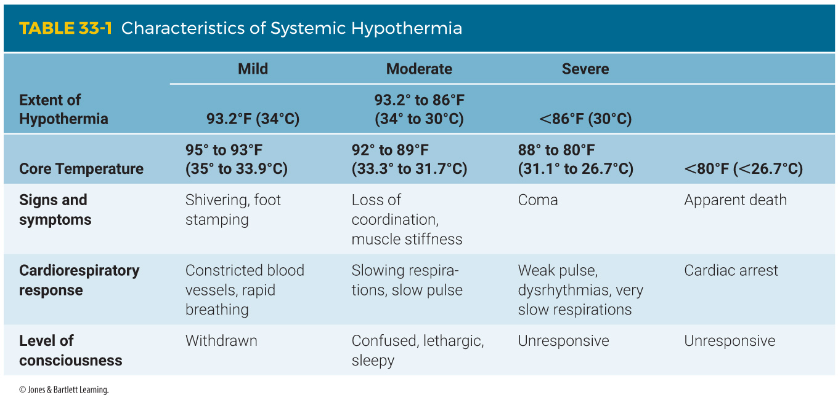
Hypothermia (3 of 7)
Signs and symptoms become more severe as the core temperature falls.
Progresses through four stages
Notes:
Lecture Outline
6. Signs and symptoms
a. Become more severe as the body’s core temperature falls
b. Hypothermia generally progresses through four stages (see Table 33-1).

Slide 18
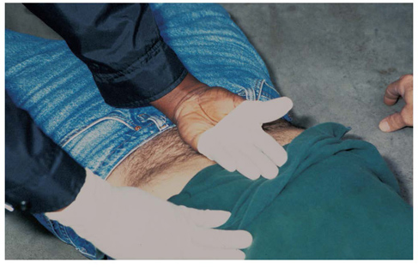
Hypothermia (4 of 7)
Assess general temperature.
  Pull back your gloves and place the back of your hand on the patient’s abdomen.
FIGURE 33-1 To assess a patient’s core body temperature,
pull back your glove and place the back of your hand on
the patient’s skin at the abdomen.
© Jones & Bartlett Learning.
Notes:
Lecture Outline
c. Assess general temperature.
i. Pull back your glove and place the back of your hand on the patient’s abdomen.
ii. If the abdomen feels cool, the patient is likely experiencing a generalized cold emergency.
iii. A hypothermia thermometer registers lower body temperatures.

Slide 19
Hypothermia (5 of 7)
Mild hypothermia
  Occurs when the core temperature is greater than 93.2°F (34°C) but less than 98°F (36.7°C).
  Patient is usually alert and shivering.
  Pulse rate and respirations are rapid.
  Skin may appear red, pale, or cyanotic.
Notes:
Lecture Outline
d. Mild hypothermia occurs when the core temperature is greater than 93.2°F (34°C) but less than the normal 98°F (36.7°C).
i. The patient is usually alert and shivering.
ii. Pulse rate and respirations are usually rapid.
iii. Skin may appear red, pale, or cyanotic.

Slide 20
Hypothermia (6 of 7)
Moderate hypothermia exists when the core temperature is 86°F to 93.2°F (30°C to 34°C).
  Shivering stops.
  Muscular activity decreases.
Severe hypothermia occurs when the core temperature is less than 86°F (30°C).
  The patient becomes lethargic and stops fighting.
Notes:
Lecture Outline
Moderate hypothermia exists when the core temperature is 86°F to 93.2°F (30°C to 34°C).
i. Shivering stops and muscular activity decreases.
ii. Eventually, all muscle activity stops, and mental status deteriorates.
f. Severe hypothermia occurs when the core temperature is less than 86°F (30°C).
i. As the core drops toward 85°F (29°C) the patient becomes lethargic and stops fighting the cold. The patient appears stiff or rigid.

Slide 21
Hypothermia (7 of 7)
If body temperature is 80°F or less
  Pulse becomes slower and weaker.
  Cardiac dysrhythmias may occur.
  Patient may appear dead (or in a coma).
Never assume a cold, pulseless patient is dead.
Notes:
Lecture Outline
g. If the body temperature continues to fall to 80°F (27°C), the pulse becomes slower and weaker, the respirations slow and may become absent, and cardiac dysrhythmias may occur.
h. At a core temperature of less than 80°F (27°C) all cardiorespiratory activity may cease, pupillary action is slow, and the patient may appear dead.
i. Never assume that a cold, pulseless patient is dead.

Slide 22
Local Cold Injuries (1 of 5)
Most injuries from cold are confined to exposed parts of the body.
Frostnip
Immersion foot (trench foot)
Frostbite
Notes:
Lecture Outline
F. Local cold injuries
1. Most injuries from cold are confined to exposed parts of the body.
2. When exposed parts of the body become very cold but not frozen, injuries such as frostnip and immersion foot (trench foot) can result.
3. When the parts become frozen, the injury is called frostbite.

Slide 23
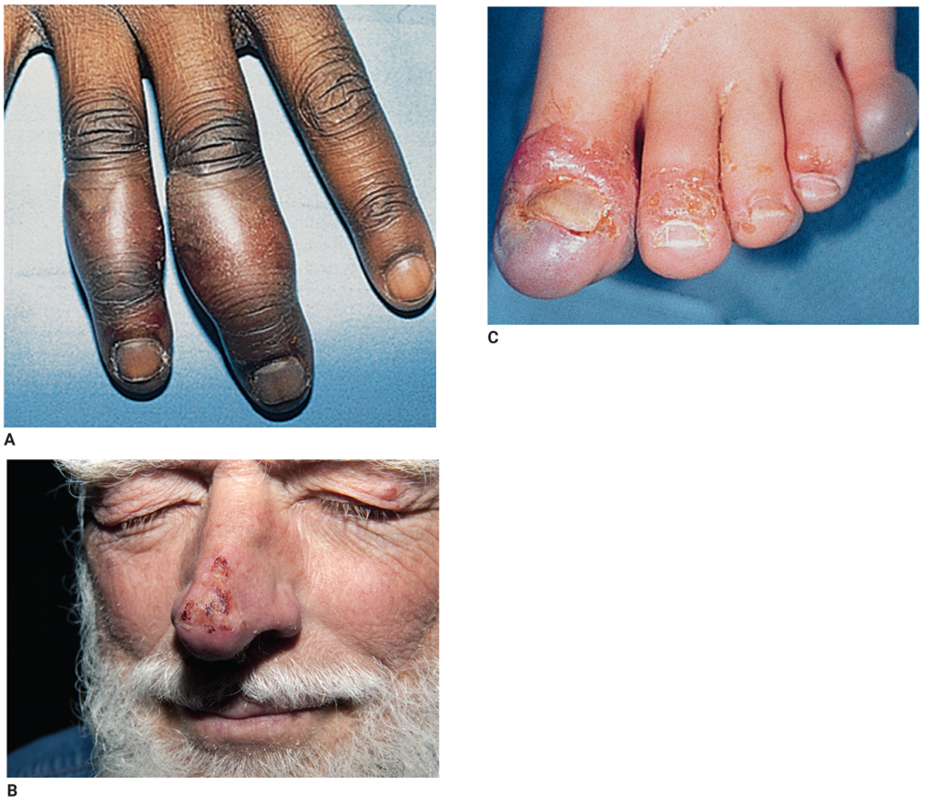
Local Cold Injuries (2 of 5)
FIGURE 33-2 The (A) hands, (B) nose, and (C) feet are
particularly susceptible to frostbite.
A: Courtesy of Neil Malcom Winkelmann; B: © Dr. P. Marazzi/Science Source; C: © Chuck Stewart, MD.
Notes:
The figures on this slide show frostbite to the extremities and face.

Slide 24
Local Cold Injuries (3 of 5)
Important factors in determining the severity of a local cold injury
  Duration of the exposure
  Temperature to which the body part was exposed
  Wind velocity during exposure
Notes:
Lecture Outline
4. Important factors in determining the severity of a local cold injury:
a. Duration of the exposure
b. Temperature to which the body part was exposed
c. Wind velocity during exposure

Slide 25
Local Cold Injuries (4 of 5)
Consider underlying factors.
  Exposure to wet conditions
  Inadequate insulation from cold or wind
  Restricted circulation from tight clothing or shoes or circulatory disease
  Fatigue
  Poor nutrition
Notes:
Lecture Outline
5. Consider underlying factors:
a. Exposure to wet conditions
b. Inadequate insulation from cold or wind
c. Restricted circulation from tight clothing or shoes or circulatory disease
d. Fatigue
e. Poor nutrition

Slide 26
Local Cold Injuries (5 of 5)
Underlying factors (cont’d)
  Alcohol or drug abuse
  Hypothermia
  Diabetes
  Cardiovascular disease
  Age
Notes:
Lecture Outline
f. Alcohol or drug abuse
g. Hypothermia
h. Diabetes
i. Cardiovascular disease
j. Age
6. Patients with hypothermia should also be assessed for frostbite or other local cold injury.

Slide 27
Frostnip and Immersion Foot (1 of 3)
Frostnip
  After prolonged exposure to the cold, skin may freeze while deeper tissues are unaffected.
  Usually affects the ear, nose, and fingers
  Usually not painful, so the patient often is unaware that a cold injury has occurred.
Notes:
Lecture Outline
7. Frostnip and immersion foot
a. Frostnip
i. After prolonged exposure to the cold, skin may freeze while deeper tissues are unaffected.
ii. Usually affects the ears, nose, and fingers
iii. Usually not painful, so the patient often is unaware that a cold injury has occurred

Slide 28
Frostnip and Immersion Foot (2 of 3)
Immersion foot
  Occurs after prolonged exposure to cold water
  Common in hikers and hunters
Notes:
Lecture Outline
b. Immersion foot
i. Occurs after prolonged exposure to cold water
ii. Common in hikers or hunters who stand for a long time in a river or lake

Slide 29
Frostnip and Immersion Foot (3 of 3)
Signs and symptoms
  Pale, cool skin
  Normal color does not return after palpation of the skin.
  The skin of the foot may be wrinkled.
  Loss of feeling and sensation in the injured area
Notes:
Lecture Outline
Signs and symptoms
i. Pale, cool skin.
ii. Skin of the foot may be wrinkled but can also remain soft.
iv. Loss of feeling and sensation in the injured area

Slide 30
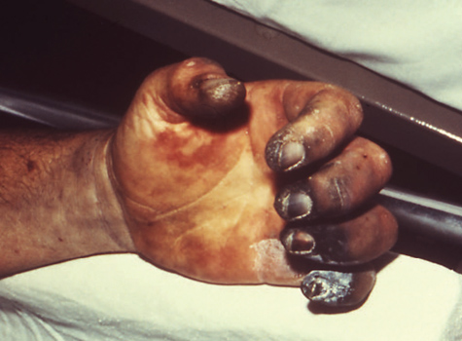
Frostbite (1 of 3)
Most serious local cold injury because the tissues are actually frozen.
Gangrene requires surgical removal of dead tissue.
FIGURE 33-3 Gangrene (necrosis), or permanent cell
death, occurs when tissue is frozen and destructive
chemical changes occur in the cells.
Courtesy of Dr. Jack Poland/CDC.
Notes:
Lecture Outline
8. Frostbite
a. Most serious local cold injury because the tissues are actually frozen.
i. Freezing permanently damages cells.
b. Gangrene (permanent damage or cell death) requires surgical removal of dead tissue.
i. The exposed part will become inflamed, tender to touch, and unable to tolerate exposure to cold.

Slide 31
Frostbite (2 of 3)
Signs and symptoms
  Hard, waxy feel of the affected tissues
  The injured part feels firm.
  Blisters and swelling may be present.
Notes:
Lecture Outline
c. Signs and symptoms
i. Most frostbitten parts are hard and waxy.
ii. The injured part feels firm to frozen as you gently touch it.
iii. Blisters and swelling may be present.

Slide 32
Frostbite (3 of 3)
The depth of skin damage will vary.
  With superficial frostbite, only the skin is frozen.
  With deep frostbite, deeper tissues are frozen.
  You may not be able to tell superficial from deep frostbite in the field.
Notes:
Lecture Outline
d. The depth of skin damage will vary.
i. With superficial frostbite, only the skin is frozen.
ii. With deep frostbite, deeper tissues are frozen.

Slide 33
Scene Size-up (1 of 2)
Scene safety
  Note the environmental conditions.
  Ensure that the scene is safe for you and other responders.
  Identify safety hazards such as icy roads, mud, or wet grass.
  Use appropriate standard precautions.
Notes:
Lecture Outline
IV. Assessment of Cold Injuries
A. Management of hypothermia in the field, regardless of severity, consists of stabilizing the ABCs and preventing further heat loss.
B. Scene size-up
1. Note the environmental conditions.
a. Air temperature
b. Wind chill
c. Wet or dry
2. Ensure that the scene is safe for you and other responders.
a. Identify safety hazards such as icy roads, mud, or wet grass.
b. Use appropriate standard precautions.

Slide 34
Scene Size-up (2 of 2)
Scene safety (cont’d)
  Consider the number of patients.
  Summon additional help as quickly as possible.
Mechanism of injury/nature of illness
  Look for indicators of the MOI.
Notes:
Lecture Outline
3. Look for indicators of the MOI.

Slide 35
Primary Assessment (1 of 4)
Form a general impression.
  Perform a rapid scan.
  If a life threat exists, treat it.
  Check core temperature.
  Evaluate mental status using the AVPU scale.
  An altered mental status can be affected by the intensity of the cold injury.
Notes:
Lecture Outline
C. Primary assessment
1. Form a general impression.
a. Perform a rapid scan to determine whether a life threat exists and, if so, treat it.
b. If the chief complaint is simply being cold, quickly assess the patient’s core temperature.
c. Evaluate the patient’s mental status quickly using the AVPU scale.

Slide 36
Primary Assessment (2 of 4)
If the patient is in cardiac arrest, begin compressions.
Airway and breathing
  Ensure that the patient has an adequate airway and is breathing.
  Warmed, humidified oxygen helps warm the patient from the inside out.
Notes:
Lecture Outline
2. Airway, breathing, and circulation
a. If you believe the patient is in cardiac arrest, proceed directly to the circulation step by providing high-quality chest compressions, then address airway and breathing.
b. Ensure that the patient has an adequate airway and is breathing.
c. If your patient’s breathing is slow or shallow, ventilation with a bag-mask device may be necessary.
d. Warmed, humidified oxygen helps warm the patient from the inside out.

Slide 37
Primary Assessment (3 of 4)
Circulation
  Palpate for a carotid pulse and wait for up to 60 seconds to decide if the patient is pulseless.
  The AHA recommends that CPR be started on a patient who has no detectable pulse or breathing.
  Perfusion will be compromised.
  Bleeding may be difficult to find.
Notes:
Lecture Outline
e. Palpate for a carotid pulse and wait for up to 60 seconds to decide if the patient is pulseless.
f. The American Heart Association recommends that CPR be started on a patient who has no detectable pulse or breathing.
g. Perfusion will be compromised based on the degree of cold the patient is experiencing.
h. Bleeding may be difficult to find because of the slow-moving circulation and thick clothing.

Slide 38
Primary Assessment (4 of 4)
Transport decision
  Complications can include cardiac dysrhythmias and blood clotting abnormalities.
  All patients with hypothermia require immediate transport.
  Rough handling of a hypothermic patient may cause a cold, slow, weak heart to fibrillate.
Notes:
Lecture Outline
3. Transport decision
a. Complications can include cardiac dysrhythmias and blood clotting abnormalities.
b. All patients with hypothermia require immediate transport.
c. Rough handling of a hypothermic patient may cause a cold, slow, weak heart to fibrillate and the patient to lose any pulse.
d. If transportation is delayed, protect the patient from further heat loss.

Slide 39
History Taking
Investigate the chief complaint.
  Obtain a medical history.
  Be alert for injury-specific signs and symptoms and any pertinent negatives.
SAMPLE history
  Find out how long your patient has been exposed to the cold environment.
  Exposures may be short or prolonged.
Notes:
Lecture Outline
D. History taking
1. Investigate the chief complaint.
a. Obtain a medical history.
b. Be alert for injury-specific signs and symptoms as well as any pertinent negatives.
2. SAMPLE history
a. If possible, find out how long your patient has been exposed to the cold environment.
b. Exposures may be short or prolonged.
c. Medications and underlying medical problems may have an impact on the way cold affects the patient’s metabolism.
d. The patient’s last oral intake and what the patient was doing prior to the exposure will help to determine the severity of the cold problem.

Slide 40
Secondary Assessment (1 of 3)
Physical examinations
  Focus on the severity of hypothermia.
  Assess the areas of the body directly affected by cold exposure.
  Assess the degree and extent of damage.
Notes:
Lecture Outline
E. Secondary assessment
1. Physical examinations
a. Focus on the severity of hypothermia.
b. Assess the areas of the body directly affected by cold exposure as well as the degree and extent of damage.
c. Pay special attention to skin temperatures, textures, and turgor.

Slide 41
Secondary Assessment (2 of 3)
Vital signs
  May be altered by the effects of hypothermia and can be an indicator of its severity
  Respirations may be slow and shallow.
  Low blood pressure and a slow pulse indicate moderate to severe hypothermia.
  Evaluate for changes in mental status.
Notes:
Lecture Outline
2. Vital signs
a. May be altered by the effects of hypothermia and can be an indicator of its severity.
b. Respirations may be slow and shallow, resulting in low oxygen levels in the body.
c. Low blood pressure and a slow pulse also indicate moderate to severe hypothermia.
d. Evaluate for changes in mental status using the AVPU scale.

Slide 42
Secondary Assessment (3 of 3)
Monitoring devices
  Determine a core body temperature using a hypothermia thermometer.
  Pulse oximetry will often be inaccurate.
Notes:
Lecture Outline
d. Determine a core body temperature using a hypothermia thermometer, based on local protocol.

Slide 43
Reassessment (1 of 2)
Repeat the primary assessment.
Reassess vital signs and the chief complaint.
Monitor the patient’s level of consciousness and vital signs.
Rewarming can lead to cardiac dysrhythmias.
Notes:
Lecture Outline
F. Reassessment
1. Repeat the primary assessment.
2. Reassess vital signs and the chief complaint.
3. Monitor the patient’s level of consciousness and vital signs.
4. Rewarming can lead to cardiac dysrhythmias.

Slide 44
Reassessment (2 of 2)
Communicate all of the information you have gathered to the receiving facility.
  Patient’s physical status
  Conditions at the scene
  Any changes in the patient’s mental status during treatment and transport
Notes:
Lecture Outline
6. Communication and documentation
a. Communicate all of the information you have gathered to the receiving facility.

Slide 45
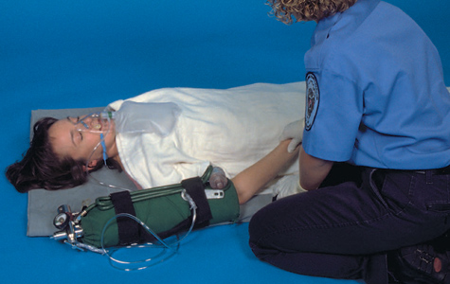
General Management of Cold Emergencies (1 of 4)
Move the patient from the cold environment.
Remove any wet clothing.
Place dry blankets over and under the patient.
FIGURE 33-5 Place dry blankets over and under the patient with hypothermia; give warm, humidified oxygen, if available.
© Jones & Bartlett Learning. Courtesy of MIEMSS.
Notes:
Lecture Outline
V. General Management of Cold Emergencies
A. Move the patient from the cold environment to prevent further heat loss.
1. To prevent further damage to the feet, do not allow the patient to walk.
2. Remove any wet clothing and place dry blankets over and under the patient.

Slide 46
General Management of Cold Emergencies (2 of 4)
If available, give the patient warm, humidified oxygen.
Handle the patient gently.
Do not massage the extremities.
Do not allow the patient to eat or use any stimulants.
Notes:
Lecture Outline
3. If available, give the patient warm, humidified oxygen.
4. Handle the patient gently.
5. Do not massage the extremities.
6. Do not allow the patient to eat or use any stimulants (eg, coffee, tea, soda, or tobacco)

Slide 47
General Management of Cold Emergencies (3 of 4)
Mild hypothermia
  Patient is alert, shivering, and responds appropriately.
  Place the patient in a warm environment, and remove wet clothing.
  Apply heat packs or hot water bottles to the groin, axillary, and cervical regions.
  Give warm fluids by mouth.
Notes:
Lecture Outline
B. Mild hypothermia
1. Patient is alert, shivering, and responds appropriately.
2. Treatment involves passive rewarming
a. Place the patient in a warm environment and remove wet clothing.
b. Apply heat packs or hot water bottles to the groin, axillary, and cervical regions.
c. Turn up the heat to high in the patient compartment of the ambulance.
d. Give warm fluids by mouth (if the patient can swallow).

Slide 48
General Management of Cold Emergencies (4 of 4)
Moderate or severe hypothermia
  Do not try to actively rewarm the patient.
  The goal is to prevent further heat loss.
  Remove the patient from the cold environment.
  Remove wet clothing, cover with a blanket, and transport.
Notes:
Lecture Outline
C. Moderate or severe hypothermia
1. Do not try to actively rewarm the patient—rewarming may cause a fatal cardiac dysrhythmia.
2. Local protocols may dictate the appropriate type of rewarming strategies based on the patient’s body temperature.
3. The goal is to prevent further heat loss.
4. Remove the patient immediately from the cold environment.
5. Remove wet clothing.
6. Cover the patient with a blanket and transport.
7. Handle the patient gently to decrease the risk of ventricular fibrillation.
8. If you cannot get the patient out of the cold immediately:
a. Move the patient out of the wind and away from contact with any object that will conduct heat away from the body.
b. Place blankets and a waterproof protective cover on the patient.
c. Cover the head and neck with a towel.
9. Always remember that even an unresponsive patient may be able to hear you.

Slide 49
Emergency Care of Local Cold Injuries (1 of 3)
Remove the patient from further exposure to the cold.
Handle the injured part gently and protect it from further injury.
Remove any wet or restricting clothing over the injured part.
Notes:
Lecture Outline
D. Emergency care of local cold injuries
1. Includes the following steps:
a. Remove the patient from further exposure to the cold.
b. Handle the injured part gently and protect it from further injury.
c. Remove any wet or restricting clothing from the patient, especially over the injured part.

Slide 50
Emergency Care of Local Cold Injuries (2 of 3)
If transport will be delayed, consider active rewarming.
  With frostnip, contact with a warm object may be all that is needed.
  With immersion foot, remove wet shoes, boots, and socks, and rewarm the foot gradually.
  With a late or deep cold injury, do not apply heat or rewarm the part.
  Never rub or massage injured tissues.
Notes:
Lecture Outline
2. If there is no chance of reinjury or if transport to the ED will be significantly delayed, consider active rewarming if local protocols allow.
a. Consult medical control if available.
b. With frostnip, contact with a warm object may be all that is needed.
c. Immersion foot, remove wet shoes, boots, and socks.
i. Rewarm the foot gradually, protecting it from further cold exposure.
ii. Cover the affected loosely with a dry, sterile dressing.
iii. Never rub or massage injured tissues; rubbing can cause further damage.
iv. Do not re-expose the injury to cold.
d. Late or deep cold injury (frostbite):
i. Remove any jewelry from the injured part.
ii. Cover the injury loosely with a dry, sterile dressing.
iii. Do not break blisters or rub or massage the area.
iv. Do not apply heat or rewarm the part.
v. Do not allow the patient to stand or walk on a frostbitten foot.

Slide 51
Emergency Care of Local Cold Injuries (3 of 3)
Rewarming in the field
  Immerse the frostbitten part in water between 102°F and 104°F.
  Dress the area with dry, sterile dressings.
  If blisters have formed, do not break them.
  Never attempt rewarming if there is any chance that the part may freeze again.
Notes:
Lecture Outline
3. Rewarming in the field
a. If prompt hospital care is not available and medical control instructs you to begin rewarming in the field, use a warm-water bath.
b. Immerse the frostbitten part in water with a temperature of between 102°F and 104°F (40°C and 41°C).
c. Dress the area with dry, sterile dressings (including between injured fingers or toes).
d. Expect the patient to report severe pain.
e. Never attempt rewarming if there is any chance that the part may freeze

Slide 52
Cold Exposure and You
You are at risk for hypothermia if you work in a cold environment.
If cold weather search-and-rescue is possible in your area, you need:
  Survival training
  Precautionary tips
Wear appropriate clothing.
Notes:
Lecture Outline
VI. Cold Exposure and You
A. You are at risk for hypothermia yourself if you work in a cold environment.
1. If cold weather search-and-rescue is possible in your area, then you should receive survival training and precautionary tips.
2. Stay on top of weather forecasts.
3. Make sure proper clothing is available and wear it whenever appropriate.
4. Your vehicle must also be properly equipped and maintained.

Slide 53
Heat Exposure (1 of 3)
In a hot environment, the body tries to rid itself of excess heat.
  Sweating and dilation of skin blood vessels
  Removal of clothing and relocation to a cooler environment
Notes:
Lecture Outline
VII. Heat Exposure
A. In a hot environment or during vigorous physical activity, the body tries to rid itself of excess heat.
1. Sweating and dilation of skin blood vessels
2. Removal of clothing and relocation to a cooler environment

Slide 54
Heat Exposure (2 of 3)
Hyperthermia is a core temperature of 101°F (38.3°C) or higher.
Risk factors of heat illness:
  High air temperature (reduces radiation)
  High humidity (reduces evaporation)
  Lack of acclimation to the heat
  Vigorous exercise (loss of fluid and electrolytes)
Notes:
Lecture Outline
B. Hyperthermia is a core temperature of 101°F (38.3°C) or higher.
C. Risk factors of heat illness
1. High air temperature (reduces radiation)
2. High humidity (reduces evaporation)
3. Lack of acclimation to the heat
4. Vigorous exercise (loss of fluid and electrolytes)
D. Forms of heat emergency:
1. Heat cramps
2. Heat exhaustion
3. Heat stroke
4. All three forms may be present in the same patient.

Slide 55
Heat Exposure (3 of 3)
Persons at greatest risk for heat illnesses are:
  Children (especially newborns and infants)
  Geriatric patients
  Patients with heart disease, COPD, diabetes, dehydration, and obesity
  Patients with limited mobility
Notes:
Lecture Outline
E. Persons at greatest risk for heat illnesses are:
1. Children (especially newborns and infants)
2. Geriatric patients
3. Patients with heart disease, COPD, diabetes, dehydration, and obesity
4. Patients with limited mobility
5. Alcohol and certain drugs also make a person more susceptible to heat illnesses.
a. Cause dehydration
b. Decrease the ability to sweat

Slide 56
Heat Cramps
Painful muscle spasms that occur after vigorous exercise
Do not occur only when it is hot outdoors
Exact cause is not well understood.
Usually occur in the leg or abdominal muscles
Notes:
Lecture Outline
F. Heat cramps
1. Painful muscle spasms that occur after vigorous exercise
2. Do not occur only when it is hot outdoors
3. Exact cause is not well understood
4. Usually occur in the leg or abdominal muscles

Slide 57
Heat Exhaustion (1 of 2)
Most common illness caused by heat
Causes:
  Hypovolemia as the result of the loss of water and electrolytes
  High humidity
  Exertion in poorly ventilated areas
Notes:
Lecture Outline
G. Heat exhaustion
1. Also called heat prostration or heat collapse
2. Causes
a. Hypovolemia as the result of the loss of water and electrolytes from heavy sweating
b. High humidity decreases the amount of evaporation that can occur.
c. Exertion in poorly ventilated areas.

Slide 58
Heat Exhaustion (2 of 2)
Signs and symptoms
  Dizziness, weakness, or syncope
  Nausea, vomiting, or headache
  Cold, clammy skin with ashen pallor
  Dry tongue and thirst
  Normal vital signs
  Normal or slightly elevated body temperature
Notes:
Lecture Outline
3. Signs and symptoms
a. Dizziness, weakness, or syncope
b. Nausea, vomiting, or headache.
c. Cold, clammy skin with ashen pallor
d. Dry tongue and thirst
e. Normal vital signs (pulse is often rapid and weak)
f. Normal or slightly elevated body temperature (can be as high as 104°F or 40°C)

Slide 59
Heatstroke (1 of 3)
Least common but most serious illness caused by heat exposure
Occurs when the body is subjected to more heat than it can handle, and normal mechanisms are overwhelmed.
Untreated heatstroke always results in death.
Notes:
Lecture Outline
H. Heatstroke
1. Least common but most serious illness caused by heat exposure
2. Occurs when the body is subjected to more heat than it can handle and normal mechanisms for getting rid of the excess heat are overwhelmed
3. Untreated heatstroke always results in death.

Slide 60
Heatstroke (2 of 3)
Typical onset situations
  During vigorous physical activity
  Outdoors or in a closed, poorly ventilated, humid space
  During heat waves without sufficient air conditioning or poor ventilation
  Children left unattended in a locked car on a hot day
Notes:
Lecture Outline
4. Typical onset situations
a. During vigorous physical activity
b. Outdoors or in a closed, poorly ventilated, humid space
c. During heat waves in buildings without sufficient air conditioning or with poor ventilation
d. Children left unattended in a locked car on a hot day

Slide 61
Heatstroke (3 of 3)
Signs and symptoms
  Hot, dry, flushed skin
  Quickly rising body temperature
  Change in behavior
  Unresponsiveness and seizures
  Rapid, weak pulse
  Increased respiratory rate
  Cessation of perspiring
Notes:
Lecture Outline
5. Signs and symptoms
a. Hot, dry, flushed skin (patient may still sweat even with heatstroke)
b. Rapid rise in body temperature up to 106°F (41.1°C)
c. Change in behavior
d. Unresponsiveness and seizures
e. Rapid, weak pulse that becomes weaker
f. Increased respiratory rate
g. Perspiring stops

Slide 62
Scene Size-up
Scene safety
  Perform an environmental assessment.
  The heat emergency may be secondary to a medical or trauma emergency.
  Consider calling ALS.
  Look for indicators of MOI.
  Stay hydrated.
  Use appropriate standard precautions, including gloves and eye protection.
Notes:
Lecture Outline
VIII. Assessment of Heat Injuries
A. Scene size-up
1. Perform an environmental assessment.
a. Remember that the heat emergency may be secondary to a medical or trauma emergency.
b. If the patient is unconscious, has an altered mental status, or requires intravenous fluids to treat shock, consider calling for ALS assistance.
c. Look for indicators of the MOI.
d. Protect yourself from heat and biologic hazards.
i. Stay hydrated
ii. Use appropriate standard precautions, including gloves and eye protection.

Slide 63
Primary Assessment (1 of 3)
Form a general impression.
  Observe how the patient interacts with you and the environment.
  Introduce yourself and ask about the chief complaint.
  Perform a rapid scan, and avoid tunnel vision.
  Assess mental status using AVPU.
Notes:
Lecture Outline
B. Primary assessment
1. Form a general impression.
a. Observe how the patient interacts with you and the environment.
b. A heat emergency may be the primary or secondary condition.
c. Perform a rapid scan and avoid tunnel vision.
d. Assess the patient’s mental status using the AVPU scale.

Slide 64
Primary Assessment (2 of 3)
Airway and breathing
  Unless the patient is unresponsive, the airway should be patent.
  Nausea and vomiting may occur.
  Position the patient to protect the airway.
  Consider spinal immobilization.
  If unresponsive, insert an airway and provide bag-mask ventilations.
Notes:
Lecture Outline
2. Airway and breathing
a. Unless the patient is unresponsive, the airway should be patent.
b. Nausea and vomiting may occur.
c. Position the patient to protect the airway as necessary.
d. If the patient is unresponsive, be cautious of how you open the airway and consider spinal immobilization if trauma is a possibility.
e. If the patient is unresponsive, insert an airway and provide bag-mask ventilations.

Slide 65
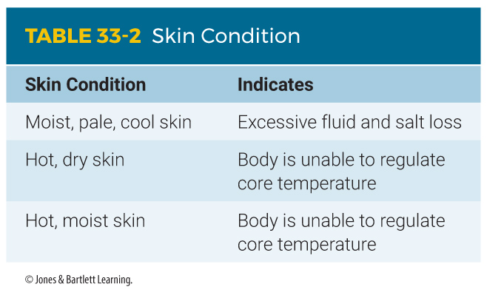
Primary Assessment (3 of 3)
Circulation
  If adequate, assess for perfusion and bleeding.
  Assess the patient’s skin condition.
  Treat for shock.
Notes:
Lecture Outline
3. Circulation
a. If adequate, assess for perfusion and bleeding.
b. Assess the patient’s skin condition.
c. Treat for shock by removing the patient from the heat and positioning the patient to improve circulation.
d. If the patient is bleeding, bandage according to protocol.
e. If the patient has any signs of heat stroke, provide rapid transport.

Slide 66
History Taking (1 of 2)
Investigate the chief complaint.
  Be alert for injury-specific signs and symptoms.
    Absence of perspiration
    Decreased level of consciousness
    Confusion
    Muscle cramping
    Nausea
    Vomiting
Notes:
Lecture Outline
C. History taking
1. Investigate the chief complaint.
a. Be alert for specific signs and symptoms.

Slide 67
History Taking (2 of 2)
SAMPLE History
  Note any activities, conditions, or medications.
    Inadequate oral intake
    Diuretics
    Medications
  Determine exposure to heat and humidity and activities prior to onset.
Notes:
Lecture Outline
2. SAMPLE history
a. Note any activities, conditions, or medications that may predispose a patient to dehydration or heat-related problems.
b. Determine your patient’s exposure to heat and humidity and activities prior to the onset of symptoms.

Slide 68
Secondary Assessment (1 of 2)
Physical examinations
  Assess the patient for muscle cramps or confusion.
  Examine the patient’s mental status and vital signs.
  Pay special attention to skin temperature, turgor, and level of moisture.
  Perform a careful neurologic examination.
Notes:
Lecture Outline
D. Secondary assessment
1. Physical examination
a. If the patient is unresponsive, perform a secondary assessment on the entire body.
b. If the patient is conscious, perform an assessment of specific areas of the body.
c. Assess the patient for muscle cramps or confusion.
d. Examine the patient’s mental status and take vital signs.
e. Pay special attention to the patient’s skin temperature, turgor, and level of moisture.
f. Gently pinch the skin on the forehead or back of the hand.
g. Perform a careful neurologic examination.

Slide 69
Secondary Assessment (2 of 2)
Vital signs
  Patients who are hyperthermic will be tachycardic and tachypneic.
  Falling blood pressure indicates that the patient is going into shock.
  In heat exhaustion, the skin temperature may be normal or cool and clammy.
  In heatstroke, the skin is hot.
Notes:
Lecture Outline
2. Vital signs
a. Patients who are hyperthermic will be tachycardic and tachypneic.
b. Falling blood pressure indicates that the patient is going into shock.
c. In heat exhaustion, the skin temperature may be normal or cool and clammy.
d. In heatstroke, the skin is hot.
e. Monitoring devices
i. Check the patient’s temperature with a thermometer, depending on protocol.
ii. In patients with a heat-related emergency, pulse oximetry is also indicated.

Slide 70
Reassessment (1 of 2)
Watch for deterioration.
Patients with symptoms of heatstroke should be transported immediately.
Monitor vital signs at least every 5 minutes.
Evaluate the effectiveness of interventions.
Be careful not to overcool a patient.
Notes:
Lecture Outline
E. Reassessment
1. Watch carefully for deterioration.
2. Patients with symptoms of heatstroke should be transported immediately in a cool ambulance, passively cooled with clothing removal, and actively cooled by spraying the patient with water and fanning.
3. Monitor vital signs at least every 5 minutes.
4. Evaluate the effectiveness of your interventions.
5. Be careful not to overcool a patient.

Slide 71
Reassessment (2 of 2)
Communication and documentation
  Inform the staff at the receiving facility early on that your patient is experiencing heatstroke.
  Additional resources may be required.
  Document environmental conditions and the activities the patient was performing prior to onset.
Notes:
Lecture Outline
6. Inform the staff at the receiving facility early on that your patient is experiencing heatstroke because additional resources may be required.
7. Document environmental conditions and the activities the patient was performing prior to onset.

Slide 72
Management of Heat Emergencies (1 of 3)
Heat cramps
  Remove the patient from the hot environment and loosen clothing.
  Administer high-flow oxygen if indicated.
  Rest the cramping muscles.
  Replace fluids by mouth.
  Cool the patient with water spray or mist.
Notes:
Lecture Outline
IX. Management of Heat Emergencies
A. Heat cramps
1. Take the following steps:
a. Remove the patient from the hot environment and loosen any tight clothing.
b. Administer high-flow oxygen if indicated.
c. Have the patient sit or lie down until the cramps subside.
d. Replace fluids by mouth.
e. Cool the patient with water spray or mist and add convection by manually or mechanically fanning the patient.
2. When the heat cramps are gone, the patient may resume activity.
3. The best preventive and treatment strategy is hydration by drinking water.
4. If the cramps do not go away after these measures, transport the patient to the hospital.
B. Heat exhaustion
1. To treat the patient with heat exhaustion, follow the steps in Skill Drill 33-1.

Slide 73
Management of Heat Emergencies (2 of 3)
Heatstroke
  Move the patient out of the hot environment and into the ambulance.
  Set air conditioning to maximum cooling.
  Remove the patient’s clothing.
  Administer high-flow oxygen if indicated.
  Assist ventilations as needed.
Notes:
Lecture Outline
C. Heatstroke
1. Recovery from heat stroke depends on the speed with which treatment is administered.
2. Emergency treatment has one objective: Lower the body temperature by any means available.
3. Take the following steps when treating a patient with heatstroke:
a. Move the patient out of the hot environment and into the ambulance.
b. Set the air conditioning to maximum cooling.
c. Remove the patient’s clothing.
d. Administer high-flow oxygen and assist ventilations if indicated.

Slide 74
Management of Heat Emergencies (3 of 3)
Heatstroke (cont’d)
  Cover the patient with wet towels or sheets.
  Aggressively fan the patient.
  Exclude other causes of altered mental status.
  Check blood glucose level if possible.
  Transport immediately to the hospital.
  Notify the hospital.
  Call for ALS if the patient begins to shiver.
Notes:
Lecture Outline
e. Provide cold water immersion, if possible.
f. Spray the patient with cool water and fan him or her to quickly evaporate the moisture on the skin.
g. Aggressively and repeatedly fan the patient.
h. Exclude other causes of altered mental status and check blood glucose level, if possible.
i. Transport immediately to the hospital.
j. Notify the hospital of an arriving heat stroke patient.
k. Do not overcool the patient. Call for ALS assistance if the patient begins to shiver.

Slide 75
Drowning (1 of 2)
Process of experiencing respiratory impairment from submersion or immersion in liquid
Some agencies may still use the term “near drowning” to refer to a patient who survives at least 24 hours after suffocation in water.
Notes:
Lecture Outline
X. Drowning
A. Drowning is the process of experiencing respiratory impairment from submersion or immersion in liquid.
1. Some agencies may still use the term “near drowning” to refer to a patient who survives at least temporarily (24 hours) after suffocation in water.

Slide 76
Drowning (2 of 2)
Risk factors
  Alcohol consumption
  Preexisting seizure disorders
  Geriatric patients with cardiovascular disease
  Unsupervised access to water
Laryngospasm
  Inhaling water causes the muscles of the larynx and vocal cords to spasm.
Notes:
Lecture Outline
Risk factors
1. Alcohol consumption
2. Preexisting seizure disorders
3. Geriatric patients with cardiovascular disease
4. Unsupervised access to water (for children)
C. Drowning is often the last in a cycle of events caused by panic in the water.
1. It can happen to anyone who is submerged in water for even a short period of time.
2. Struggling toward the surface or the shore, the person becomes fatigued or exhausted, which leads him or her to sink even deeper.
3. Drowning also occurs in buckets, puddles, bathtubs, and places where the person is not completely submerged.
D. Laryngospasm
1. Inhaling very small amounts of either fresh water or salt water can cause the muscles of the larynx and the vocal cords spasm.
2. Prevents more water from entering the lungs
3. In severe cases, progressive hypoxia occurs until the patient becomes unconscious.

Slide 77
Spinal Injuries in Submersion Incidents (1 of 2)
Submersion incidents may be complicated by spinal fractures and spinal cord injuries.
Assume spinal injury if:
  Submersion resulted from a diving mishap or fall.
  The patient is unconscious.
  The patient complains of weakness, paralysis, or numbness.
Notes:
Lecture Outline
E. Spinal injuries in submersion incidents
1. Submersion incidents may be complicated by spinal fractures and spinal cord injuries.
2. Assume that spinal injury exists with the following conditions:
a. The submersion has resulted from a diving mishap or significant fall.
b. The patient is unconscious, and no information is available to rule out the possibility of a neck injury.
c. The patient is conscious but complains of weakness, paralysis, or numbness in the arms or legs.

Slide 78
Spinal Injuries in Submersion Incidents (2 of 2)
Most spinal injuries in diving incidents affect the cervical spine.
Stabilize the suspected injury while the patient is still in the water.
Notes:
Lecture Outline
3. Most spinal injuries in diving incidents affect the cervical spine.
4. Stabilize the suspected injury while the patient is still in the water.
a. Follow the steps in Skill Drill 33-2.

Slide 79
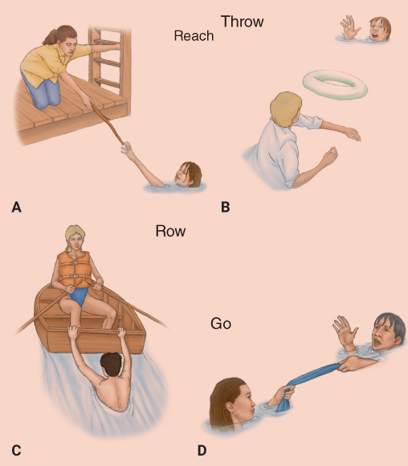
Safety
Water rescues are usually handled by specialized rescue personnel.
“Reach, throw, and row, and only then go.”
FIGURE 33-9 Basic rules of water rescue. A. Reach for the person from shore. If you cannot reach the person from shore, wade closer. B. If an object that floats is available, throw it to the person. C. Use a boat if one is available. D. If you must swim to the person, use a towel or board for him or her to hold onto. Do not let the person grab you.
© Jones & Bartlett Learning.
Notes:
Lecture Outline
F. Safety
1. Ensure the safety of rescue personnel and request additional resources for a water rescue.
2. The basic rule of water rescue is, “reach, throw, and row, and only then go.”
3. Do not attempt a swimming rescue unless you are trained and experienced in the proper techniques.
4. If you work in an area near lakes, rivers, or the ocean, you should have prearranged plan for water rescue.

Slide 80
Recovery Techniques
If the patient is not floating or visible in the water, an organized rescue effort is necessary.
Specialized personnel are required, with snorkel, mask, and scuba gear.
Notes:
Lecture Outline
G. Recovery techniques
1. If the patient is not floating or visible in the water, an organized rescue effort is necessary.
2. Specialized personnel are required (with snorkel, mask, and scuba gear).

Slide 81
Resuscitation Efforts
Never give up on resuscitating a cold-water drowning victim.
  Hypothermia can protect vital organs from the lack of oxygen.
The diving reflex may cause immediate bradycardia.
  Slowing of the heart rate caused by submersion in cold water
Notes:
Lecture Outline
H. Resuscitation efforts
1. Never give up on resuscitating a cold-water drowning victim.
a. Hypothermia can protect vital organs from the lack of oxygen.
2. The diving reflex (slowing of the heart rate caused by submersion in cold water) may cause immediate bradycardia (slow heart rhythm).
a. The person may be able to survive for an extended period of time under water, thanks to a lowering of the metabolic rate associated with hypothermia.
b. Local protocols often dictate that resuscitative efforts continue for up to 1 hour after submersion, while simultaneously rewarming the patient.

Slide 82
Descent Emergencies (1 of 2)
Caused by the sudden increase in pressure as the person dives deeper into the water
Typical areas affected
  Lungs
  Sinus cavities
  Middle ear
  Teeth
  Face
Notes:
Lecture Outline
XI. Diving Emergencies
A. Many serious water-related injuries are associated with dives, with or without scuba gear.
B. Medical emergencies relating to scuba diving techniques and equipment are becoming increasingly common.
1. Separated into three phases: descent, bottom, and ascent
C. Descent emergencies
1. Caused by the sudden increase in pressure on the body as the person dives deeper into the water
2. The lungs, sinus cavities, middle ear, teeth, and area surrounded by the diving mask are most commonly affected.

Slide 83
Descent Emergencies (2 of 2)
The pain forces the diver to return to the surface to equalize the pressures, and the problem clears up by itself.
Perforated tympanic membrane
  Cold water may enter the middle ear through a ruptured eardrum.
  The diver may lose his or her balance, shoot to the surface, and run into ascent problems.
Notes:
Lecture Outline
3. Usually, the pain caused by these “squeeze problems” forces the diver to return to the surface to equalize the pressures, and the problem clears up by itself.
4. Divers with continued pain (particularly in the ear) after returning to the surface should be transported to the hospital.
5. Perforated tympanic membrane (ruptured eardrum)
a. Cold water may enter the middle ear through a ruptured eardrum.
b. The diver may lose his or her balance and orientation.
c. The diver may then shoot to the surface and run into ascent problems.

Slide 84
Emergencies at the Bottom
Rarely occur
Caused by faulty connections in the diving gear
  Inadequate mixing of oxygen and carbon dioxide in the air the diver breathes
  Accidental feeding of poisonous carbon monoxide into the breathing apparatus
Can cause drowning or rapid ascent
Notes:
Lecture Outline
D. Emergencies at the bottom
1. Rarely occur
2. Caused by faulty connections in the diving gear
a. Inadequate mixing of oxygen and carbon dioxide in the air the diver breathes
b. Accidental feeding of poisonous carbon monoxide into the breathing apparatus
3. Can cause drowning or rapid ascent
4. Require emergency resuscitation and transport

Slide 85
Ascent Emergencies (1 of 5)
Usually requires aggressive resuscitation
Air embolism
  Most dangerous and most common scuba diving emergency
  Bubbles of air in the blood vessels
  Air pressure in the lungs remains at a high level while pressure on the chest decreases.
Notes:
Lecture Outline
E. Ascent emergencies
1. Most serious injuries and usually require aggressive resuscitation
2. Air embolism
a. Most dangerous and most common scuba-diving emergency
b. Bubbles of air in the blood vessels
c. The problem starts when the diver holds his or her breath during a rapid ascent.
i. The air pressure in the lungs remains at a high level while the external pressure on the chest decreases.
ii. The air inside the lungs expands rapidly, causing the alveoli in the lungs to rupture.
d. May cause a pneumothorax, pneumomediastinum, or air embolism.
e. Signs and symptoms of air embolism
i. Blotching (mottling of the skin)
ii. Froth (often pink or bloody) at the nose and mouth
iii. Severe pain in muscles, joints, or abdomen
iv. Dyspnea and/or chest pain
v. Dizziness, nausea, and vomiting
vi. Dysphasia (difficulty speaking)
vii. Cough
viii. Cyanosis
ix. Difficulty with vision
x. Paralysis and/or coma
xi. Irregular pulse and cardiac arrest

Slide 86
Ascent Emergencies (2 of 5)
Decompression sickness
  “The bends”
  Bubbles of gas, especially nitrogen, obstruct the blood vessels.
  Conditions that can cause the bends:
    Too rapid an ascent from a dive
    Too long of a dive at too deep of a depth
    Repeated dives within a short period
Notes:
Lecture Outline
3. Decompression sickness (“the bends”)
a. Bubbles of gas, especially nitrogen, obstruct the blood vessels.
b. Results from too rapid an ascent from a dive, too long of a dive at too deep a depth, or repeated dives within a short period of time.
c. Nitrogen that is being breathed dissolves in the blood and tissues.

Slide 87
Ascent Emergencies (3 of 5)
Decompression sickness (cont’d)
  Complications
    Blockage of tiny blood vessels
    Depriving parts of the body of their normal blood supply
    Severe pain in certain tissues or spaces
  Signs and symptoms
    Abdominal/joint pain so severe that the patient doubles up
Notes:
Lecture Outline
d. Complications
i. Blockage of tiny blood vessels
ii. Depriving parts of the body of their normal blood supply
iii. Severe pain in certain tissues or spaces
e. Signs and symptoms
i. Abdominal/joint pain so severe that the patient doubles up (“bends”)

Slide 88
Ascent Emergencies (4 of 5)
You may find it difficult to distinguish between air embolism and decompression sickness.
  Air embolism generally occurs immediately on return to the surface.
  Symptoms of decompression sickness may not occur for several hours.
Notes:
Lecture Outline
4. You may find it difficult to distinguish between air embolism and decompression sickness.
a. Air embolism generally occurs immediately on return to the surface.
b. Symptoms of decompression sickness may not occur for several hours.

Slide 89
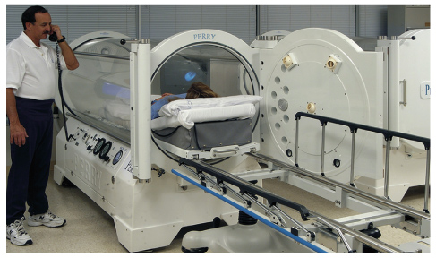
Ascent Emergencies (5 of 5)
Treatment is the same for both.
  Basic life support (BLS)
  Recompression in a hyperbaric chamber
FIGURE 33-11 A hyperbaric chamber, usually a small
room, is pressurized to a level higher than atmospheric
pressure and used in the treatment of decompression
sickness and air embolism.
Courtesy of Perry Baromedical Corporation.
Notes:
Lecture Outline
c. Emergency treatment is the same for both and includes BLS and recompression in a hyperbaric chamber.

Slide 90
Scene Size-up
Scene safety
  Gloves and eye protection
  Never drive through moving water; be cautious driving through still water.
  Never attempt a water rescue without proper training and equipment.
  Consider trauma and spinal immobilization.
  Check for additional patients.
Notes:
Lecture Outline
XII. Assessment of Drowning and Diving Emergencies
A. Scene size-up
1. Scene safety
a. Your standard precautions should include gloves and eye protection at a minimum.
b. Never attempt a water rescue without the proper training and equipment.
c. Call for additional resources early.
d. Trauma and spinal immobilization must be considered in recreational settings.
2. Look for indicators of the MOI.

Slide 91
Primary Assessment (1 of 4)
Form a general impression.
  Pay attention to chest pain, dyspnea, and complaints of sensory changes.
  Determine level of consciousness using the AVPU scale.
  Be suspicious of drug or alcohol use.
Airway and breathing
  Open the airway and assess breathing in unresponsive patients.
Notes:
Lecture Outline
B. Primary assessment
1. Form a general impression
a. Pay attention to chest pain, dyspnea, and complaints of sensory changes when a diving emergency is suspected.
b. Determine the patient’s level of consciousness using the AVPU scale.
c. Be suspicious of drug or alcohol use.
2. Airway and breathing
a. Open the airway and assess breathing in unresponsive patients.

Slide 92
Primary Assessment (2 of 4)
Airway and breathing (cont’d)
  Consider spinal trauma and take appropriate actions.
  Suction if the patient has vomited.
  Provide ventilations with a bag-mask for inadequate breathing.
  If the patient is responsive, provide high-flow oxygen with a nonrebreathing mask.
  Auscultate and monitor breath sounds.
Notes:
Lecture Outline
b. Consider the possibility of spinal trauma and take appropriate actions.
c. Suction if the patient has vomited.
d. Provide ventilations with a bag-valve mask for inadequate breathing in conjunction with an airway adjunct if needed.
e. If the patient is responsive, provide high-flow oxygen with a nonrebreathing mask.
f. Auscultation and frequent reassessment of breath sounds in drowning patients is a key part of your assessment.

Slide 93
Primary Assessment (3 of 4)
Circulation
  It may be difficult to find a pulse.
  Begin CPR, and apply your AED.
  Evaluate for shock and perfusion.
  If the MOI suggests trauma, assess for bleeding and treat appropriately.
Notes:
Lecture Outline
3. Circulation
a. It may be difficult to find a pulse.
b. Begin CPR, and apply your AED.
c. Evaluate for shock and adequate perfusion.
d. If the MOI suggests trauma, assess for bleeding and treat appropriately.

Slide 94
Primary Assessment (4 of 4)
Transport decision
  Always transport near-drowning patients to the hospital.
  Inhalation of any amount of fluid can lead to delayed complications.
  Decompression sickness and air embolism must be treated in a recompression chamber.
Notes:
Lecture Outline
4. Transport decision
a. Always transport patients to the hospital.
b. Inhalation of any amount of fluid can lead to delayed complications lasting for days or weeks.
c. Decompression sickness and air embolism must be treated in a recompression chamber.

Slide 95
History Taking
Investigate the chief complaint.
  Obtain a medical history.
  Be alert for injury-specific signs and symptoms.
SAMPLE history
  Determine the depth of the dive, length of time the patient was underwater, time of onset of symptoms, and previous diving activity.
Notes:
Lecture Outline
C. History taking
1. Investigate the chief complaint.
a. Obtain a medical history.
b. Be alert for injury-specific signs and symptoms as well as any pertinent negatives.
2. Determine the depth of the dive, the length of time the patient was underwater, the time of onset of symptoms, and previous diving activity.

Slide 96
Secondary Assessment (1 of 3)
Physical examinations
  Examine lungs and breath sounds.
  Look for hidden life threats and trauma, indications of the bends or air embolism, and signs of hypothermia.
  Complete a detailed full-body scan en route to the hospital.
Notes:
Lecture Outline
D. Secondary assessment
1. Physical examinations
a. If the patient is responsive, thoroughly examine his or her lungs, including breath sounds.
b. If unresponsive, look for hidden life threats and potential trauma, even if trauma is not suspected.
c. For scuba divers, look for indications of decompression sickness or air embolism.
d. Check for signs of hypothermia.

Slide 97
Secondary Assessment (2 of 3)
Assess for:
  Peripheral pulses
  Skin color and discoloration
  Itching
  Pain
  Paresthesia (numbness and tingling)
Notes:
Lecture Outline
e. Assess for:
i. Peripheral pulses
ii. Skin color and discoloration
iii. Itching
iv. Pain
v. Paresthesia (numbness and tingling)

Slide 98
Secondary Assessment (3 of 3)
Vital signs
  Check pulse rate, quality, and rhythm.
  Check respiratory rate, quality, and rhythm, and listen for lung sounds.
  Assess pupil size and reactivity.
Monitoring devices
  Oxygen saturation readings may be inaccurate.
Notes:
Lecture Outline
2. Vital signs
a. Check the patient’s pulse rate, quality, and rhythm.
i. May be difficult to palpate in the hypothermic patient
ii. Check for both peripheral and central pulses.
iii. Listen over the chest for a heartbeat if pulses are weak.
b. Check the respiratory rate, quality, and rhythm, and listen for lung sounds.
c. Assess and document pupil size and reactivity.
d. Oxygen saturation readings may produce a false low reading because of hypoperfusion or shivering.

Slide 99
Reassessment (1 of 2)
Repeat the primary assessment.
  Drowning patients may deteriorate rapidly due to:
    Pulmonary injury
    Fluid shifts in the body
    Cerebral hypoxia
    Hypothermia
  Pneumothorax, air embolism, or decompression sickness patients may decompensate quickly.
Notes:
Lecture Outline
E. Reassessment
1. Repeat the primary assessment
a. Drowning patients may deteriorate rapidly due to:
i. Pulmonary injury
ii. Fluid shifts in the body
iii. Cerebral hypoxia
iv. Hypothermia
b. Patients with pneumothorax, air embolism or decompression sickness may decompensate quickly.
c. Assess your patient’s mental status constantly.
d. Assess vital signs at least every 5 minutes, paying particular attention to respirations and breath sounds.

Slide 100
Reassessment (2 of 2)
Document
  Circumstances of drowning and extrication
  Time submerged
  Temperature and clarity of the water
  Possible spinal injury
  Bring all dive equipment to the hospital, including dive log or dive computer
Notes:
Lecture Outline
Document the circumstances of the drowning and extrication:
a. Time submerged
b. Temperature of the water
c. Clarity of the water
d. Possible spinal injury
3. Bring all dive equipment to the hospital, including a dive log or dive computer if available.

Slide 101
Emergency Care for Drowning or
Diving Emergencies (1 of 2)
Immobilize and protect the patient’s spine if a fall or diving injury is possible.
If the patient is not breathing:
  Assist ventilations with a bag-mask device or pocket mask.
  Provide chest compressions and use the AED if indicated.
  Treat for hypothermia.
Notes:
Lecture Outline
XIII. Emergency Care for Drowning or Diving Emergencies
Treatment for drowning begins with rescue and removal from the water.
1. Immobilize and protect the patient’s spine when a fall from a significant height or suspected diving injury is possible.
2. Artificial ventilation should begin as soon as possible, even before the victim is removed from the water.
If the patient is not breathing:
1. Remove any vomit from the airway manually or by suction.
2. Assist ventilations with a bag-mask device or pocket mask.
3. Provide chest compressions and use the AED if the patient is in cardiac arrest.
4. Administer oxygen if the patient is breathing spontaneously.
5. Treat for hypothermia.

Slide 102
Emergency Care for Drowning or
Diving Emergencies (2 of 2)
For air embolism or decompression sickness in a conscious patient:
  Remove the patient from the water.
  Try to keep the patient calm.
  Administer oxygen.
  Consider the possibility of pneumothorax, and monitor breath sounds.
  Provide prompt transport.
Notes:
Lecture Outline
C. When treating conscious patients who are suspected of having an air embolism or decompression sickness from scuba diving, follow these treatment steps:
1. Remove the patient from the water and try to keep him or her calm.
2. Administer oxygen.
3. Consider the possibility of pneumothorax, and monitor breath sounds.
4. Provide prompt transport to the ED or to the nearest recompression facility for treatment based on local protocols.

Slide 103
Other Water Hazards
Pay close attention to the body temperature of a person who is rescued from cold water.
Breath-holding syncope
  A person swimming in shallow water may experience a loss of consciousness caused by a decreased stimulus for breathing.
  Treatment is the same as a drowning patient.
Notes:
Lecture Outline
D. Other water hazards
1. Pay close attention to the body temperature of a person who is rescued from cold water.
2. Treat hypothermia caused by immersion in cold water the same way you treat hypothermia caused by cold exposure.
3. Breath-holding syncope
a. A person swimming in shallow water may experience a loss of consciousness caused by a decreased stimulus for breathing.
b. This results in drowning, and the treatment is the same as that for a drowning patient.

Slide 104
Prevention
Appropriate precautions can prevent most immersion incidents.
  All pools should be surrounded by a fence.
  The most common problem in child drownings is lack of adult supervision.
  Half of all teenage and adult drownings are associated with the use of alcohol.
Notes:
Lecture Outline
E. Prevention
1. Appropriate precautions can prevent most immersion incidents.
a. All pools should be surrounded by a fence. The most common problem in child drownings is lack of adult supervision.
b. Half of all teenage and adult drownings are associated with the use of alcohol.

Slide 105
High Altitude (1 of 6)
Dysbarism injuries
  Caused by the difference between the surrounding atmospheric pressure and the total gas pressure in the body
Altitude illness
  Caused by diminished oxygen in the air at high altitudes
  Affects the central nervous system and pulmonary system
Notes:
Lecture Outline
XIV. High Altitude
A. Dysbarism injuries
1. Caused by the difference between the surrounding atmospheric pressure and the total gas pressure in various tissues, fluids, and cavities of the body
B. Altitude illnesses
1. Occur when an unacclimatized person is exposed to diminished oxygen pressure in the air at high altitudes.
2. Illnesses affect the central nervous system and pulmonary system, and range from acute mountain sickness to high-altitude cerebral edema (HACE) and high-altitude pulmonary edema (HAPE).

Slide 106
High Altitude (2 of 6)
Acute mountain sickness
  Diminished oxygen in the air at higher altitudes
  Caused by ascending too high, too fast or not being acclimatized to high altitudes
  Signs and symptoms
    Headache
    Light-headedness
    Fatigue
Notes:
Lecture Outline
C. Acute mountain sickness (above 5,000 feet)
1. Caused by diminished oxygen pressure in the air at altitudes above 5,000 feet resulting in hypoxia.
2. Results from ascending too high, too fast or not being acclimatized to high altitudes
3. Signs and symptoms
a. Headache
b. Light-headedness
c. Fatigue

Slide 107
High Altitude (3 of 6)
Acute mountain sickness signs and symptoms (cont’d)
  Loss of appetite
  Nausea
  Difficulty sleeping
  Shortness of breath during physical exertion
  Swollen face
Notes:
Lecture Outline
d. Loss of appetite
e. Nausea
f. Difficulty sleeping
g. Shortness of breath during physical exertion
h. Swollen face
4. Treatment primarily consists of stopping the ascent and descending to a lower altitude.

Slide 108
High Altitude (4 of 6)
High-altitude pulmonary edema (HAPE)
  Fluid collects in the lungs, hindering the passage of oxygen into the bloodstream.
  Signs and symptoms
    Shortness of breath
    Cough with pink sputum
    Cyanosis
    Rapid pulse
Notes:
Lecture Outline
D. High-altitude pulmonary edema (HAPE) (above 8,000 feet)
1. Fluid collects in the lungs, hindering the passage of oxygen into the bloodstream.
2. Signs and symptoms include shortness of breath, cough with pink sputum, cyanosis, and a rapid pulse.

Slide 109
High Altitude (5 of 6)
High-altitude cerebral edema (HACE)
  May accompany HAPE and can quickly become life threatening
  Signs and symptoms
    Severe, constant, throbbing headache
    Ataxia
    Extreme fatigue
    Vomiting
    Loss of consciousness
Notes:
Lecture Outline
E. High-altitude cerebral edema (HACE) (above 12,000 feet)
1. May accompany HAPE and can quickly become life threatening
2. Signs and symptoms
a. Severe, constant, throbbing headache
b. Ataxia (lack of muscle coordination and balance)
c. Extreme fatigue
d. Vomiting
e. Loss of consciousness

Slide 110
High Altitude (6 of 6)
Treatment of HAPE and/or HACE
  Provide oxygen.
  Descend from the height.
  Transport promptly.
  Provide positive pressure ventilation with a bag-mask device for inadequate respirations.
Notes:
Lecture Outline
F. Treatment of HAPE and/or HACE
1. Descend to a lower altitude
2. Provide oxygen
3. Rapid transport
4. For inadequate respirations, provide positive pressure ventilation with a bag-mask device.
5. CPAP may be helpful for a patient with respiratory distress from HAPE.

Slide 111
Lightning (1 of 4)
Lightning is the fifth most common cause of death from isolated environmental phenomena.
Targets of direct lightning strikes:
  People engaged in outdoor activities
  Anyone in a large, open area
Notes:
Lecture Outline
XV. Lightning
A. There are an estimated 25 million cloud-to-ground lightning strikes each year in the United States.
B. Lightning is the fifth-most-common cause of death from isolated environmental phenomena.
C. Targets of direct lightning strikes:
1. People engaged in outdoor activities
2. Anyone in a large, open area

Slide 112
Lightning (2 of 4)
Many individuals are indirectly struck when standing near an object that has been struck by lightning, such as a tree.
The cardiovascular and nervous systems are most commonly injured.
  Respiratory or cardiac arrest is the most common cause of lightning-related deaths.
Notes:
Lecture Outline
D. Many individuals are indirectly struck when standing near an object that has been struck by cardiovascular and nervous systems are most commonly injured.
1. Respiratory or cardiac arrest is the most common cause of lightning-related deaths.
2. The tissue damage pathway usually occurs over the skin, rather than through it.
3. Because the duration of a lightning strike is short, skin burns are usually superficial.

Slide 113
Lightning (3 of 4)
Categories of lightning injuries
  Mild
    Loss of consciousness, amnesia, confusion, tingling, superficial burns
  Moderate
    Seizures, respiratory arrest, dysrhythmias, superficial burns
  Severe
    Cardiopulmonary arrest
Notes:
Lecture Outline
F. Categories of lightning injuries
1. Mild
a. Loss of consciousness
b. Amnesia
c. Confusion
d. Tingling
e. Other nonspecific signs and symptoms
f. Superficial burns.
2. Moderate
a. Seizures
b. Respiratory arrest
c. Dysrhythmias that spontaneously resolve
d. Superficial burns
3. Severe
a. Cardiopulmonary arrest

Slide 114
Lightning (4 of 4)
Emergency medical care
  Protect yourself.
  Move the patient to a sheltered area.
  Use reverse triage.
  Treatment
    Stabilize the spine, and open the airway.
    Assist ventilations or use an AED.
    Control bleeding and transport.
Notes:
Lecture Outline
G. Emergency medical care
1. Take measures to protect yourself from being struck by lightning.
2. Move the patient to a sheltered area.
3. Use reverse triage.
a. Anyone who is in cardiac or respiratory arrest is the first priority.
b. Other people who may have been struck will not develop cardiac complications.
4. Treatment
a. Stabilize the spine and open the airway with the jaw-thrust maneuver.
b. If a pulse is present, assist ventilations.
c. If the patient is in cardiac arrest, use an AED as soon as possible.
d. Control bleeding.
e. Transport to the nearest facility.
f. A patient with signs and symptoms of a lightning strike, but no obvious life threats, should still be transported for evaluation.

Slide 115
Spider Bites
Spiders are numerous and widespread in the United States.
  Many species of spiders bite.
  Only the female black widow spider and the brown recluse spider deliver serious or life-threatening bites.
Notes:
Lecture Outline
XVII. Bites and Envenomations
A. Spider bites
1. Spiders are numerous and widespread in the United States.
a. Only two spiders—the female black widow spider and the brown recluse spider—deliver serious, even life-threatening bites.

Slide 116
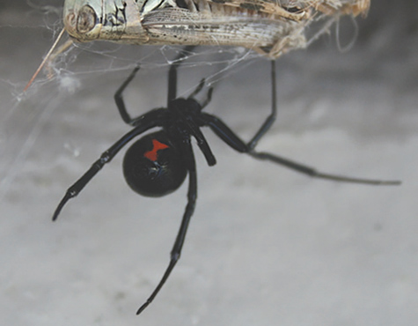
Black Widow Spider (1 of 4)
The female is fairly large, measuring approximately 2 inches across.
Usually black with a distinctive, bright red-orange marking in the shape of an hourglass on its abdomen
FIGURE 33-12 Black widow spiders are distinguished by their glossy black color and bright red-orange hourglass marking on the abdomen.
© Crystal Kirk/Shutterstock.
Notes:
Lecture Outline
2. Black widow spider
a. The female black widow spider is fairly large, measuring approximately 2 inches with its legs extended.
b. Usually black with a distinctive, bright red-orange marking in the shape of an hourglass on its abdomen

Slide 117
Black Widow Spider (2 of 4)
Found in every state except Alaska
Prefer dry, dim places
The bite is sometimes overlooked.
  Most bites cause localized pain and symptoms, including agonizing muscle spasms.
  The main danger is the venom, which is poisonous to nerve tissues.
Notes:
Lecture Outline
c. Prefer dry, dim places around buildings, in woodpiles, and among debris
d. The bite is sometimes overlooked.
i. If the site becomes numb right away, the patient may not even recall being bit; however, most black widow spider bites cause localized pain and symptoms, including agonizing muscle spasms.
ii. A bite on the abdomen may cause muscle spasms so severe that they resemble an acute abdominal condition.
iii. The main danger is the venom, which can damage nerve tissues.

Slide 118
Black Widow Spider (3 of 4)
Other systemic symptoms include:
  Dizziness
  Sweating
  Nausea
  Vomiting
  Rashes
  Tightness in the chest
  Severe cramps
Notes:
Lecture Outline
e. Other systemic symptoms include:
i. Dizziness
ii. Sweating
iii. Nausea
iv. Vomiting
v. Rashes
vi. Tightness in the chest
vii. Difficulty breathing
viii. Severe cramps

Slide 119
Black Widow Spider (4 of 4)
Generally, these symptoms subside over 48 hours.
Emergency treatment consists of BLS for the patient in respiratory distress.
Transport as soon as possible.
Notes:
Lecture Outline
f. Generally, these signs and symptoms subside over 48 hours.
g. A physician can administer a specific antivenin, but because of a high incidence of side effects, its use is reserved for very severe bites, older people, and children younger than five years.
h. Emergency treatment consists of BLS for the patient in respiratory distress.
i. Transport to the emergency department as soon as possible.
j. If possible, safely bring the spider to the hospital or take a photo of the spider with a cell phone and send it to the hospital ahead of time.

Slide 120
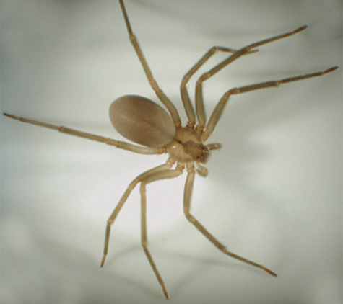
Brown Recluse Spider (1 of 2)
Dull brown in color and 1 inch long
Violin-shaped mark on its back
Lives mostly in the southern and central parts of the country
FIGURE 33-13 Brown recluse spiders are dull brown and have a dark, violin-shaped mark on the back.
Courtesy of Kenneth Cramer, Monmouth College.
Notes:
Lecture Outline
3. Brown recluse spider
a. Dull brown in color and 1 inch long
b. The short-haired body has a violin-shaped mark, brown to yellow in color, on its back.
c. Lives mostly in the southern and central parts of the country, but may be found throughout the continental United States

Slide 121
Brown Recluse Spider (2 of 2)
Tends to live in dark areas
The venom is cytotoxic.
  It causes severe local tissue damage.
  Typically, the bite is not painful at first but becomes so within hours.
  The area becomes swollen and tender, developing a pale, mottled, cyanotic center.
Notes:
Lecture Outline
d. Tends to live in dark areas, such as in the corners of old, unused buildings; under rocks; and in woodpiles
e The venom is not neurotoxic but cytotoxic; it causes severe local tissue damage.
f. Typically, the bite is not painful at first but becomes so within hours.
g. The area becomes swollen and tender, developing a pale, mottled, cyanotic center and possibly a small blister.
h. A scab of dead skin, fat, and debris will form and dig down into the skin, producing a large ulcer that may not heal unless treated promptly.
i. Transport patients with such symptoms as soon as possible.
j. These bites rarely cause systemic symptoms and signs
k. When they do, the initial treatment is BLS and transportation to the emergency department.
l. If possible, safely bring the spider to the hospital or take a photo of the spider with a cell phone and send it to the hospital ahead of time.

Slide 122
Hymenoptera Stings
Bees, wasps, yellow jackets, ants
Stings are painful but are not a medical emergency.
  Remove the stinger and venom sac using a firm-edged item such as a credit card to scrape the stinger and sac off the skin.
  Anaphylaxis may occur if the patient is allergic to the venom.
Notes:
Lecture Outline
B. Hymenoptera stings
1. Bees, wasps, yellow jackets, and ants
2. Stings are painful but are not a medical emergency.
a. Remove the stinger and venom sac using a firm-edged item such as a credit card to scrape the stinger and sac off the skin.
b. Use ice packs to assist in controlling pain from a hymenoptera sting.
3. Anaphylaxis may occur if the patient is allergic to the venom.
a. Signs and symptoms include flushed skin, low blood pressure, difficulty breathing, wheezes, hives, and/or swelling of the throat and tongue.
b. Be prepared to assist the patient in administering an EpiPen auto-injector and support the airway and breathing.

Slide 123
Snakebites (1 of 3)
Of the approximately 115 different species of snakes in the United States, only 19 are venomous.
  Rattlesnake, copperhead, cottonmouth or water moccasin, and coral snakes
Notes:
Lecture Outline
C. Snakebites
1. Snakebite fatalities in the United States are extremely rare—about 15 a year for the entire country.
a. Of the approximately 115 different species of snakes native to the United States, only 19 are venomous.
i. These include the rattlesnake, the copperhead, the cottonmouth or water moccasin, and the coral snakes.

Slide 124
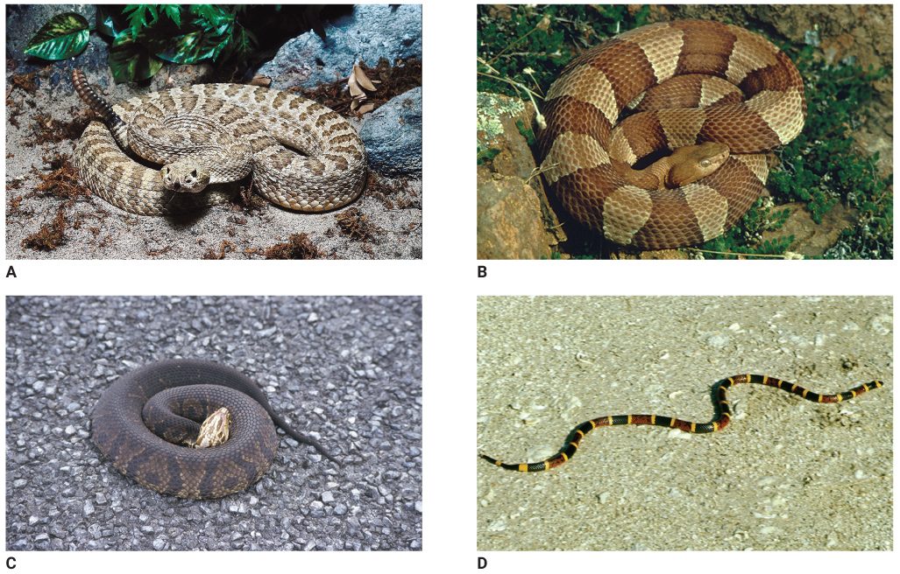
Snakebites (2 of 3)
FIGURE 33-15 A. Rattlesnake. B. Copperhead. C. Cottonmouth (water moccasin). D. Coral snake.
A: © Photos.com; B: Courtesy of Ray Rauch/US Fish & Wildlife Service; C: © SuperStock/Alamy; D: Courtesy of Luther C. Goldman/US Fish & Wildlife Service.
Notes:
The figure on this slide shows species of poisonous snakes that are found in the United States: rattlesnake (A), copperhead (B), cottonmouth or water moccasin (C), and coral snake (D).

Slide 125
Snakebites (3 of 3)
Snakes usually do not bite unless provoked, angered, or accidentally injured.
Protect yourself from getting bitten.
  Use extreme caution and wear proper PPE.
The classic appearance of the poisonous snakebite is two small puncture wounds, with discoloration, swelling, and pain.
Notes:
Lecture Outline
b. Snakes usually do not bite unless provoked, angered, or accidentally injured, as when they are stepped on (except for cottonmouths, which are often aggressive).
c. Protect yourself from getting bitten; use extreme caution on these calls and wear the proper protective equipment for the area.
d. Only one third of snakebites result in significant local or systemic injuries.
Venomous snakes native to the United States have hollow fangs in the roof of the mouth that inject the poison from two sacs at the back of the head.
a. The classic appearance of the poisonous snakebite is two small puncture wounds, usually about 0.5 inch apart, with discoloration, swelling, and pain.
b. Nonpoisonous snakes can also bite, usually leaving a horseshoe of tooth marks.
c. Fang marks are a clear indication of a poisonous snakebite.

Slide 126
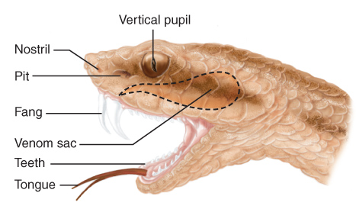
Pit Vipers (1 of 7)
Rattlesnakes, copperheads, and cottonmouths are all pit vipers, with triangular-shaped, flat heads.
  Named for small pits located just behind each nostril and in front of each eye
FIGURE 33-17 Pit vipers have small, heat-sensing organs (pits) located in front of their eyes that allow them to strike at warm targets, even in the dark.
© Jones & Bartlett Learning.
Notes:
Lecture Outline
3. Pit vipers
a. Rattlesnakes, copperheads, and cottonmouths are all pit vipers, with triangular-shaped, flat heads.
b. They take their name from the small pits located just behind each nostril and in front of each eye; the pit is a heat-sensing organ.
c. The fangs are special hollow teeth that act much like hypodermic needles connected to a sac containing a reservoir of venom.

Slide 127
Pit Vipers (2 of 7)
Rattlesnakes
  Most common form of pit viper
  Many patterns of color, diamond pattern
  Can grow to 6 feet or longer
Copperheads
  Usually 2 to 3 feet long
  Red-copper color crossed with brown and red bands
Notes:
Lecture Outline
d. Rattlesnake
i. Most common form of pit viper
ii. Have many patterns of color, often with a diamond pattern
iii. Can grow to 6 feet or more in length
e. Copperheads
i. Usually 2 to 3 feet long
ii. Red-copper color crossed with brown or red bands
iii. Typically inhabit woodpiles and abandoned dwellings
iv. Account for most of the venomous snakebites in the eastern United States

Slide 128
Pit Vipers (3 of 7)
Copperheads (cont’d)
  Their bites are almost never fatal, but the venom can cause significant damage to extremities.
Cottonmouths
  Olive or brown with black cross-bands and a yellow undersurface
  Water snakes with aggressive behavior
  Tissue destruction may be severe.
Notes:
Lecture Outline
v. Their bites are almost never fatal, but the venom can cause significant damage to tissues in the extremities.
f. Cottonmouths
i. Grow to about 4 feet in length
ii. Also called water moccasins
iii. Olive or brown, with black cross-bands and a yellow undersurface
iv. They are water snakes with an aggressive pattern of behavior.
v. Fatalities from these snakebites are rare, tissue destruction from the venom may be severe.

Slide 129
Pit Vipers (4 of 7)
Signs of envenomation
  Severe burning pain at the site of injury
  Swelling and blue discoloration
  Weakness
  Nausea and vomiting
  Sweating
  Seizures
  Fainting
Notes:
Lecture Outline
g. The signs of envenomation by a pit viper are severe burning pain at the site of injury, followed by swelling and a blue discoloration (ecchymosis).
h. Signs are evident within 5 to 10 minutes and spread over the next 36 hours.
i. In addition to destroying tissues locally, the venom of the pit viper can also interfere with the body’s clotting mechanism and cause bleeding at various distant sites.
j. Other signs that may or may not occur include:
i. Weakness
ii. Nausea
iii. Vomiting
iv. Sweating
v. Seizures
vi. Fainting

Slide 130
Pit Vipers (5 of 7)
Signs of envenomation (cont’d)
  Vision problems
  Changes in level of consciousness
  Shock
If swelling has occurred, use a pen to mark its edges on the skin.
Notes:
Lecture Outline
vii. Vision problems
viii. Changes in level of consciousness
xi. Shock
k. If swelling has occurred, use a pen to mark its edges on the skin.

Slide 131
Pit Vipers (6 of 7)
Treatment
  Calm the patient, and place in a supine position.
  Locate the bite area and clean it gently with soap and water.
  Be alert for an anaphylactic reaction and treat with an epinephrine auto-injector as appropriate.
  Do not give anything by mouth and be alert for vomiting.
Notes:
Lecture Outline
l. When treating a bite from a pit viper, take the following steps:
i. Calm the patient.
ii. Place the patient in a supine position and explain that staying quiet will slow the spread of any venom through the system.
iii. Locate the bite area and clean it gently with soap and water.
iv. Do not apply ice.
v. If the bite occurred on an arm or leg, consider the use of a pressure immobilization bandage of the extremity, then place the affected extremity below the level of the heart.
vi. Be alert for an anaphylactic reaction to the venom, and treat with an epinephrine auto-injector, as appropriate.
vii. Do not give anything by mouth and be alert for vomiting.

Slide 132
Pit Vipers (7 of 7)
Treatment (cont’d)
  If the bite occurred on the trunk, keep the patient supine and quiet, and transport as quickly as possible.
  If there are any signs of shock, treat for it.
  If the snake has been killed, bring it with you.
  Notify the hospital that you are bringing in a patient with a snakebite.
  Transport promptly.
Notes:
Lecture Outline
viii. If the patient was bitten on the trunk, keep him or her supine and quiet and transport as quickly as possible.
ix. Monitor vital signs and mark the skin with a pen over the area that is swollen to note whether swelling is spreading.
x. If there are any signs of shock, treat for it.
xi. If the snake has been killed, bring it with you. Alternatively, take a picture of the snake with a cell phone and send it to the hospital ahead of time.
xii. Notify the hospital that the patient has been bitten by a snake; if possible, describe the snake.
xiii. Transport promptly.
m. If the patient shows no signs of envenomation, provide BLS as needed, place a sterile dressing over the suspected bite area, and immobilize the injury site.
n. All patients with a suspected snakebite should be taken to the emergency department.
o. Treat the wound as you would any deep puncture wound to prevent infection.

Slide 133
Coral Snakes (1 of 2)
Small reptile with a series of bright red, yellow, and black bands completely encircling the body
Lives in most southern states
Injects the venom with its teeth and tiny fangs by a chewing motion, leaving puncture wounds
Notes:
Lecture Outline
4. Coral snakes
a. Small reptile with a series of bright red, yellow, and black bands completely encircling the body
b. “Red on yellow will kill a fellow; red on black, venom will lack.”
c. It injects the venom with its teeth and tiny fangs by a chewing motion, leaving puncture or scratch-like wounds.
d. Because of its small mouth and teeth and limited jaw expansion, the coral snake usually bites its victims on a small part of the body, such as a finger or toe.

Slide 134
Coral Snakes (2 of 2)
Coral snake venom is a powerful toxin that causes paralysis of the nervous system.
  Within a few hours of being bitten, a patient will exhibit bizarre behavior, followed by progressive paralysis of eye movements and respiration.
  Antivenin is available, but most hospitals do not stock it.
Emergency care is the same as for a pit viper bite.
Notes:
Lecture Outline
e. Coral snake venom is a powerful toxin that causes paralysis of the nervous system.
f. Within a few hours of being bitten, a patient will exhibit bizarre behavior, followed by progressive paralysis of eye movements and respiration.
g. Successful treatment depends on positive identification of the snake and support of respiration.
h. Antivenin is available, but most hospitals do not stock it.
i. Emergency care of a coral snake bite are the same as a pit viper bite.

Slide 135
Scorpion Stings (1 of 3)
Scorpions are eight-legged arachnids with a venom gland and a stinger at the end of their tail.
  They are rare and live primarily in the southwestern United States and in deserts.
  With one exception, a scorpion’s sting is usually very painful, but not dangerous.
Notes:
Lecture Outline
D. Scorpion stings
1. Scorpions are eight-legged arachnids with a venom gland and a stinger at the end of their tail.
2. They are rare and live primarily in the southwestern United States and in deserts.
3. With one exception, a scorpion’s sting is usually very painful but not dangerous, causing localized swelling and discoloration.

Slide 136
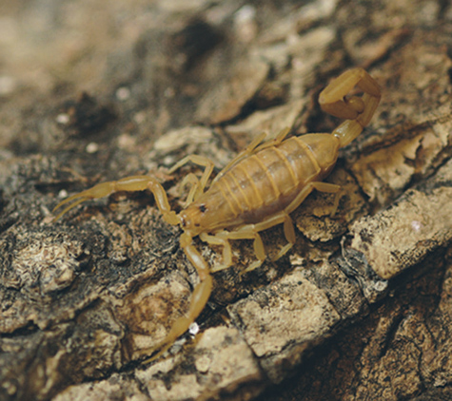
Scorpion Stings (2 of 3)
FIGURE 33-18 The sting of a scorpion is usually more painful than it is dangerous, causing localized swelling and discoloration.
© Visual & Written SL/Alamy.
Notes:
The figure on this slide shows a scorpion.

Slide 137
Scorpion Stings (3 of 3)
The exception is the Centruroides sculpturatus.
  The venom may cause:
    Circulatory collapse
    Severe muscle contractions
    Excessive salivation
    Hypertension
    Convulsions and cardiac failure
Notes:
Lecture Outline
a. The exception is the Centruroides sculpturatus.
b. The venom of this species may produce a severe systemic reaction that brings about:
i. Circulatory collapse
ii. Severe muscle contractions
iii. Excessive salivation
iv. Hypertension
v. Convulsions
vi. Cardiac failure
c. If you are called to care for a patient with a suspected sting from C. sculpturatus, notify medical control as soon as possible.
d. Administer BLS and transport the patient as rapidly as possible.

Slide 138
Tick Bites (1 of 5)
Tiny insects that usually attach themselves directly to the skin
  Found most often in brush, shrubs, trees, sand dunes, or other animals
  Only a fraction of an inch long
  Infectious diseases can be spread through the tick’s saliva
Notes:
Lecture Outline
E. Tick bites
1. Tiny insects that usually attach themselves directly to the skin.
2. Found most often on brush, shrubs, trees, sand dunes, or other animals.
3. The bite is not painful but infectious diseases can be spread through the tick’s saliva.

Slide 139
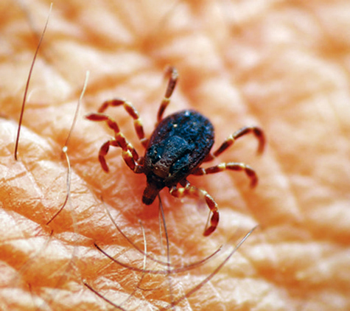
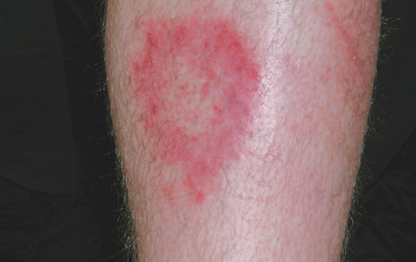
Tick Bites (2 of 5)
FIGURE 33-20 The rash associated with Lyme disease has a characteristic bull’s-eye pattern
© E. M. Singletary, MD. Used with permission.
FIGURE 33-19 Ticks typically attach themselves directly to the skin.
© Joao Estevao A. Freitas (jefras)/Shutterstock.
Notes:
The figures on this screen show a tick and the characteristic bull’s-eye pattern rash associated with Lyme disease.

Slide 140
Tick Bites (3 of 5)
Rocky mountain spotted fever
  Occurs within 7 to 10 days after the bite
  Symptoms
    Nausea
    Vomiting
    Headache
    Weakness
    Paralysis
    Cardiorespiratory collapse
Notes:
Lecture Outline
4. Rocky Mountain spotted fever
a. Occurs within 7 to 10 days after the bite
b. Symptoms
i. Nausea
ii. Vomiting
iii. Headache
iv. Weakness
v. Paralysis
vi. Cardiorespiratory collapse

Slide 141
Tick Bites (4 of 5)
Lyme disease
  Reported in all states except Hawaii
  The first symptoms are generally fever and flulike symptoms, sometimes associated with a bull’s-eye rash that may spread to several parts of the body.
  Painful swelling of the joints occurs.
  May be confused with rheumatoid arthritis
Notes:
Lecture Outline
5. Lyme disease
a. Reported in all states with the exception of Hawaii
b. The first symptoms are generally fever and flulike symptoms, sometimes associated with a bull’s-eye rash that may spread to several parts of the body.
c. After a few more days or weeks, painful swelling of the joints, particularly the knees, occurs.
d. May be confused with rheumatoid arthritis and may result in permanent disability.
e. If it is recognized and treated promptly with antibiotics, the patient may recover completely.

Slide 142
Tick Bites (5 of 5)
Tick bites occur most commonly during the summer months.
  If transport will be delayed, remove the tick by using fine tweezers to grasp the head and pull it straight out of the skin.
  Once the tick is removed, cleanse the area with antiseptic and save the tick for identification.
Notes:
Lecture Outline
6. Tick bites occur most commonly during the summer months.
a. Provide any necessary supportive emergency care and transport the patient for further evaluation.
b. In situations where access to care is delayed, remove the tick by using fine tweezers to grasp the tick by the head and pull it straight out of the skin.
c. Once the tick is removed, cleanse the area with antiseptic and save the tick in a glass jar for identification.
d. Do not handle the tick with your fingers.
f. The patient should follow up with their health care provider as soon as possible.

Slide 143
Injuries From Marine Animals (1 of 4)
Coelenterates are responsible for more envenomations than any other marine animals.
  Fire coral, Portuguese man-of-war, sea wasp, sea nettles, true jellyfish, sea anemones, true coral, and soft coral
Notes:
Lecture Outline
XVIII. Injuries From Marine Animals
A. Coelenterates are responsible for more envenomations than any other marine animals.
1. Fire coral
2. Portuguese man-of-war
3. Sea wasp
4. Sea nettles
5. True jellyfish
6. Sea anemones
7. True coral
8. Soft coral

Slide 144
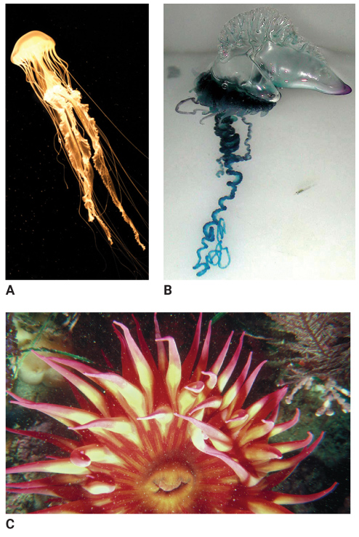
Injuries From Marine Animals (2 of 4)
FIGURE 33-21 Coelenterates are responsible for many marine envenomations. A. Jellyfish.
B. Portuguese manof-war. C. Sea anemone
A: © Creatas/Alamy; B: Courtesy of NOAA; C: Photos.com.
Notes:
The figures on this screen show examples of coelenterates: jellyfish (A), Portuguese man-of-war (B), and sea anemone (C).

Slide 145
Injuries From Marine Animals (3 of 4)
Signs and symptoms
  Very painful, red lesions in light-skinned individuals
  Headache
  Dizziness
  Muscle cramps
  Fainting
Notes:
Lecture Outline
B. The stinging cells are called nematocysts.
C. Signs and symptoms
1. Very painful, red lesions in light-skinned individuals
2. Lesions extended in a line from the site of the sting
3. Headache
4. Dizziness
5. Muscle cramps
6. Fainting

Slide 146
Injuries From Marine Animals (4 of 4)
Emergency treatment
  Limit further discharge of nematocysts by avoiding fresh water, wet sand, showers, or careless manipulation of the tentacles.
  Keep the patient calm.
  Reduce motion of the affected extremity.
  Remove the remaining tentacles by scraping them off with the edge of a sharp, stiff object.
  Provide transport to the emergency department.
Notes:
Lecture Outline
D. Treatment:
1. Remove the patient from the water.
2. Remove the tentacles by scraping them off with the edge of a sharp, stiff object such as a credit card.
3. Do not try to manipulate the remaining tentacles; this will only cause further discharge of the nematocysts.
4. On rare occasions, a patient may have a systemic allergic reaction.
a. Treat such a patient for anaphylactic shock.
b. Give BLS and provide immediate transport to the hospital.
E. Toxins from the spines of urchins, stingrays, and certain spiny fish such as the lionfish, scorpion fish, or stonefish are heat sensitive.
1. The best treatment is to immobilize the affected area and soak it in hot water for 30 minutes.
2. The patient still needs to be transported.
F. If you work near the ocean, you should be familiar with the marine life in your area.
The emergency treatment of common coelenterate envenomations consists of the following steps:
1. Limit further discharge of nematocysts by avoiding fresh water, wet sand, showers, or careless manipulation of the tentacles.
2. Keep the patient calm and reduce motion of the affected extremity.
3. Remove the remaining tentacles by scraping them off with the edge of a sharp, stiff object.
4. Immersion in vinegar may also help alleviate the symptoms.
5. Provide transport to the emergency department.

Slide 147
Review
When a person is exposed to cold temperatures and strong winds for an extended period of time, he or she will lose heat mostly by:
  radiation.
  convection.
  conduction.
  evaporation.

Slide 148
Review
Answer: B
Rationale: Convection occurs when heat is transferred to circulating air, as when cool air moves across the body surface. A person wearing lightweight clothing and standing outside in cold, windy weather is losing heat to the environment mostly by convection.

Slide 149
Review
When a person is exposed to cold temperatures and strong winds for an extended period of time, he or she will lose heat mostly by:
  radiation.
  Rationale: Radiation is the transfer of heat by radiant energy.
  convection.
  Rationale: Correct answer
  conduction.
  Rationale: Conduction is the direct transfer of heat by contact.
  evaporation.
  Rationale: Body moisture evaporates and cools the body.

Slide 150
Review
Shivering in the presence of hypothermia indicates that the:
  musculoskeletal system is damaged.
  nerve endings are damaged, causing loss of muscle control.
  body is trying to generate more heat through muscular activity.
  thermoregulatory system has failed and body temperature is falling.

Slide 151
Review
Answer: C
Rationale: Shivering in the presence of hypothermia indicates that the body is trying to generate more heat (thermogenesis) through muscular activity. In early hypothermia, shivering is a voluntary attempt to produce heat; as hypothermia progresses, shivering becomes involuntary.

Slide 152
Review
Shivering in the presence of hypothermia indicates that the:
  musculoskeletal system is damaged.
  Rationale: Hypothermia is not a physical injury.
  nerve endings are damaged, causing loss of muscle control.
  Rationale: Hypothermia is not a physical injury.
  body is trying to generate more heat through muscular activity.
  Rationale: Correct answer
  thermoregulatory system has failed and body temperature is falling.
  Rationale: The thermoregulatory system has not failed; it is producing heat and keeping the body warm.

Slide 153
Review
All of the following are examples of passive rewarming techniques, EXCEPT:
  removing cold, wet clothing.
  administering warm fluids by mouth.
  turning up the heat inside the ambulance.
  covering the patient with warm blankets.

Slide 154
Review
Answer: B
Rationale: Passive rewarming involves allowing the patient’s body temperature to rise gradually and naturally. Removing cold, wet clothing; turning up the heat in the ambulance; and covering the patient with warm blankets are examples of passive rewarming. Administering warmed fluids by mouth or intravenously is an example of active rewarming; this should be avoided in the uncontrolled prehospital setting.

Slide 155
Review
All of the following are examples of passive rewarming techniques, EXCEPT:
  removing cold, wet clothing.
  Rationale: This is passive rewarming.
  administering warm fluids by mouth.
  Rationale: Correct answer
  turning up the heat inside the ambulance.
  Rationale: This is passive rewarming.
  covering the patient with warm blankets.
  Rationale: This is passive rewarming.

Slide 156
Review
A woman has frostbite in both feet after walking several miles in a frozen field. Her feet are white, hard, and cold to the touch. Treatment at the scene should include:
  rubbing her feet gently with your own warm hands.
  trying to restore circulation by helping her to walk around.
  removing her wet clothing and rubbing her feet briskly with a warm, wet cloth.
  removing her wet clothing and covering her feet with dry, sterile dressings.

Slide 157
Review
Answer: D
Rationale: When treating a patient with frostbite, you should remove any wet clothing and cover the injured area with dry, sterile dressings. Do not break any blisters, and do not apply heat to try to rewarm the area.

Slide 158
Review
A woman has frostbite in both feet after walking several miles in a frozen field. Her feet are white, hard, and cold to the touch. Treatment at the scene should include:
  rubbing her feet gently with your own warm hands.
  Rationale: Do not rub or massage the frostbitten area.
  trying to restore circulation by helping her to walk around.
  Rationale: Do not allow the patient to stand or walk on a frostbitten foot.
  C. removing her wet clothing and rubbing her feet briskly with a warm, wet cloth.
  Rationale: Do not apply something warm or hot.
  D. removing her wet clothing and covering her feet with dry, sterile dressings.
  Rationale: Correct answer

Slide 159
Review
A 30-year-old male, who has been playing softball all day in a hot environment, complains of weakness and nausea shortly after experiencing a syncopal episode. Appropriate treatment for this patient includes all of the following, EXCEPT:
  giving a salt-containing solution by mouth.
  moving him to a cooler environment at once.
  administering oxygen via nonrebreathing mask.
  placing him in a supine position and elevating his legs.

Slide 160
Review
Answer: A
Rationale: Treatment for heat exhaustion begins by moving the patient to a cooler environment. Remove excess clothing, administer oxygen as needed, and place the patient supine. Elevating the patient’s legs may improve blood flow to the brain and prevent another syncopal episode. If the patient is not nauseated, give a salt-containing solution by mouth. Give nothing by mouth if the patient is nauseated; doing so increases the risks of vomiting and aspiration.

Slide 161
Review
A 30-year-old male, who has been playing softball all day in a hot environment, complains of weakness and nausea shortly after experiencing a syncopal episode. Appropriate treatment for this patient includes all of the following, EXCEPT:
  giving a salt-containing solution by mouth.
  Rationale: Correct answer
  moving him to a cooler environment at once.
  Rationale: This is an appropriate treatment for heat exhaustion.
  administering oxygen via nonrebreathing mask.
  Rationale: This is an appropriate treatment for heat exhaustion.
  placing him in a supine position and elevating his legs.
  Rationale: This is an appropriate treatment for heat exhaustion.

Slide 162
Review
You are assessing a 27-year-old woman with a heat-related emergency. Her skin is flushed, hot, and moist, and her level of consciousness is decreased. After moving her to a cool environment, managing her airway, and administering oxygen, you should:
  give her ice water to drink.
  place her in the recovery position.
  cover her with wet sheets and fan her.
  take her temperature with an axillary probe.

Slide 163
Review
Answer: C
Rationale: This patient is experiencing heatstroke. After moving her to a cooler area, managing her airway, and administering oxygen, the single most important treatment for her involves rapid cooling. Turn on the AC in the back of the ambulance, cover her with a wet sheet, and begin fanning her. Consider applying chemical ice packs to her groin and axillae (follow local protocols). Untreated heatstroke almost always results in death due to brain damage.

Slide 164
Review
You are assessing a 27-year-old woman with a heat-related emergency. Her skin is flushed, hot, and moist; and her level of consciousness is decreased. After moving her to a cool environment, managing her airway, and administering oxygen, you should:
  give her ice water to drink.
  Rationale: Give the patient nothing by mouth.
  place her in the recovery position.
  Rationale: Place the patient in the shock position.
  cover her with wet sheets and fan her.
  Rationale: Correct answer
  take her temperature with an axillary probe.
  Rationale: The core temperatures are the most accurate.

Slide 165
Review
It is important to remove a drowning victim from the water before laryngospasm relaxes because:
  the patient will suffer less airway trauma.
  the risk of severe hypothermia is lessened.
  less water will have entered the patient’s lungs.
  you can ventilate the patient with laryngospasm.

Slide 166
Review
Answer: C
Rationale: Even small amounts of salt or fresh water will irritate the larynx, causing it to spasm (laryngospasm). This is the body’s protective mechanism. If the EMT can safely remove the patient from the water before the laryngospasm relaxes, the amount of water that enters the lungs will be minimized. It will also be easier to ventilate the patient.

Slide 167
Review
It is important to remove a drowning victim from the water before laryngospasm relaxes because:
  the patient will suffer less airway trauma.
  Rationale: A laryngospasm is the closing of the vocal cords. This process will not cause trauma to the airway.
  the risk of severe hypothermia is lessened.
  Rationale: Submersion will produce hypothermia with or without the presence of a laryngospasm.
  less water will have entered the patient’s lungs.
  Rationale: Correct answer
  you can ventilate the patient with laryngospasm.
  Rationale: A laryngospasm is an upper airway obstruction and you will not be able to ventilate until it relaxes.

Slide 168
Review
A 13-year-old girl is found floating face down in a swimming pool. Witnesses tell you that the girl had been practicing diving. After you and your partner safely enter the water, you should:
  turn her head to the side and give five back slaps.
  turn her head to the side and begin rescue breathing.
  rotate her entire body as a unit and carefully remove her from the pool.
  rotate the entire upper half of her body as a unit, supporting her head and neck.

Slide 169
Review
Answer: D
Rationale: When caring for a patient who is in the water and has possibly been injured, rotate the upper half of the body as a unit, supporting the head and neck, until the patient is face up. Open the airway with the jaw-thrust maneuver and begin artificial ventilation.

Slide 170
Review
A 13-year-old girl is found floating face down in a swimming pool. Witnesses tell you that the girl had been practicing diving. After you and your partner safely enter the water, you should:
  turn her head to the side and give five back slaps.
  Rationale: You must consider a spinal injury.
  turn her head to the side and begin rescue breathing.
  Rationale: Manual stabilization must occur when treating patients with suspected neck injuries.
  rotate her entire body as a unit and carefully remove her from the pool.
  Rationale: While in the water and placing a patient in the supine position, a controlled rotation of the upper torso will automatically cause the proper rotation of the lower torso.
  rotate the entire upper half of her body as a unit, supporting her head and neck.
  Rationale: Correct answer

Slide 171
Review
Shortly after ascending rapidly to the surface of the water while holding his breath, a 29-year-old diver begins coughing up pink, frothy sputum and complains of dyspnea and chest pain. You should suspect and treat this patient for:
  an air embolism.
  a pneumothorax.
  pneumomediastinum.
  decompression sickness.

Slide 172
Review
Answer: A
Rationale: Signs of an air embolism, which present after a person rapidly ascends to the surface of the water while holding his or her breath, include skin mottling, pink froth at the mouth or nose, muscle or joint pain, dyspnea and/or chest pain, dizziness, nausea or vomiting, visual impairment, paralysis or coma, and even cardiac arrest.

Slide 173
Review
Shortly after ascending rapidly to the surface of the water while holding his breath, a 29-year-old diver begins coughing up pink, frothy sputum and complains of dyspnea and chest pain. You should suspect and treat this patient for:
  an air embolism.
  Rationale: Correct answer
  a pneumothorax.
  Rationale: A pneumothorax is a rupture or perforation of the pleura, causing air to leak into the pleural sac.
  pneumomediastinum.
  Rationale: This is air found in the mediastinum, between the lungs.
  decompression sickness.
  Rationale: This is a condition marked by joint pain, nausea, loss of motion, and breathing difficulties.

Slide 174
Review
Three ambulances respond to a golf course where a group of six golfers were struck by lighting. Two of the golfers are conscious and alert with superficial skin burns (Group 1). The next two golfers have minor fractures and appear confused (Group 2). The last two golfers are in cardiac arrest (Group 3). According to reverse triage, which group of golfers should be treated FIRST?
  Group 1
  Group 2
  Group 3
  Groups 1 and 2; Group 3 should be tagged as deceased.

Slide 175
Review
Answer: C
Rationale: The process of triaging multiple patients who were struck by lightning differs from standard triage; it is called “reverse triage.” If the patients are alive at the scene, survival is likely. Delayed cardiac arrest following a lightning strike is uncommon. If the patients are in cardiac arrest, there is a good chance that they can be resuscitated with early, high-quality CPR and defibrillation. Therefore, Group 3 should be treated first.

Slide 176
Review (1 of 2)
Three ambulances respond to a golf course where a group of six golfers were struck by lighting. Two of the golfers are conscious and alert with superficial skin burns (Group 1). The next two golfers have minor fractures and appear confused (Group 2). The last two golfers are in cardiac arrest (Group 3). According to reverse triage, which group of golfers should be treated FIRST?
  Group 1
  Rationale: Delayed cardiac arrest following a lightning strike is uncommon. This group should not deteriorate.
  Group 2
  Rationale: Delayed cardiac arrest following a lightning strike is uncommon. This group should not deteriorate.

Slide 177
Review (2 of 2)
Three ambulances respond to a golf course where a group of six golfers were struck by lighting. Two of the golfers are conscious and alert with superficial skin burns (Group 1). The next two golfers have minor fractures and appear confused (Group 2). The last two golfers are in cardiac arrest (Group 3). According to reverse triage, which group of golfers should be treated FIRST?
  Group 3
  Rationale: Correct answer
  Groups 1 and 2; Group 3 should be tagged as deceased.
  Rationale: Group 3 has a good chance of surviving with quality CPR and defibrillation.

